Slide 1
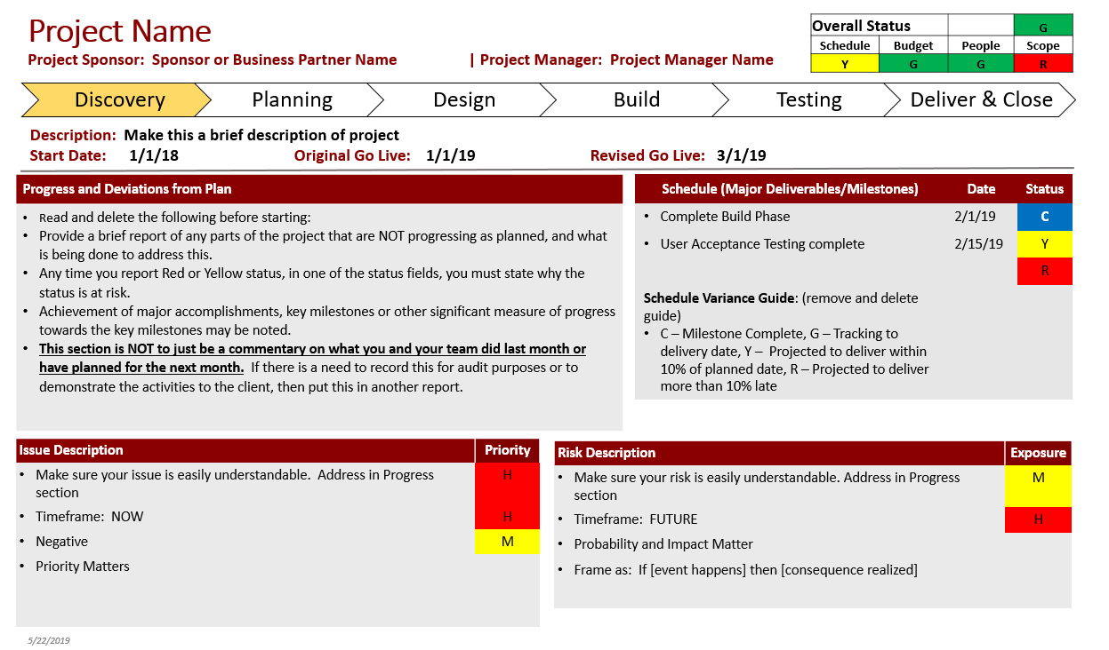
Project Status Report Template

Slide 2
Overall Status Indicator Guidelines
Overall Status |  |  | G
Schedule | Budget | People | Scope
G | G | G | G
 | Green | Yellow | Red
Schedule | The project/phase is tracking to the delivery date. | Project/phase is behind schedule, and is projected to deliver within 10% of the planned date. (e.g. 6 month project = 180 days, 18 days) | Project/phase is behind schedule and projected to deliver more than 10% late.
Budget | Project is tracking to the budget. | Project is projected to be up to 10% over budget. | Project is projected to be more than 10% over budget.
People | Project is fully resourced. | Project is under resourced by up to one FTE. | Project is under resourced by more than one FTE.
Scope | Project is on track to deliver the agreed upon scope. | Project is at risk to deliver the agreed upon scope. | Project will not be able to deliver the agreed upon scope.
Overall | Overall, the project is on track. Issues are minor and risks are mitigated. | A problem has a negative effect on project performance but can be dealt with by the project manager or project delivery team. Action is taken to resolve the problem or a decision made to watch the situation. | The project requires corrective action to meet business objectives. The issue cannot be handled solely by the project manager or project team. The matter should be escalated to the project sponsor and project board immediately.

Slide 3
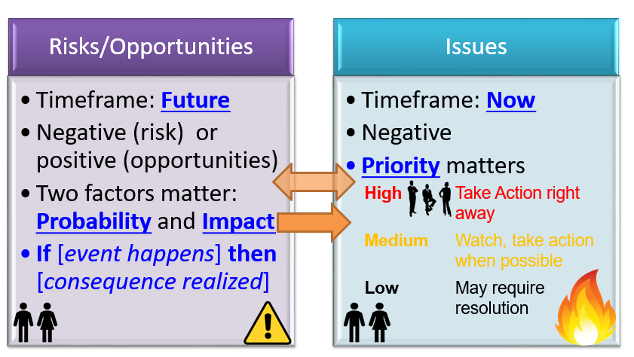
Risks and Issues

Slide 4
Risks and Issues
The key difference is an “issue” already has occurred and a “risk” is a potential issue that may or may not happen and can impact the project positively or negatively.
The main differences are related to timing and probability. Because of these differences, the language used to describe risks is future tense: “If this happens, then this will be impacted.”
There is no such thing as “mitigating an issue.” Rather, issues are resolved. Mitigation plans are all about reducing the impact or probability of a risk event.
Risks:
We plan in advance and work out mitigation plans for high-impact risks.
Issues
For all issues at hand, we need to act immediately to resolve them. We need an action plan that has action items listed in priority
For issues, the language used is in present tense: “We have this problem. How should we deal with it?”

Slide 5
Issue Guidelines
Timeframe: Happening Now
Red - High Priority:
Significant impact on project, impacts several areas (schedule, budget, scope) of project
Leadership intervention required
Yellow - Medium Priority
Cannot complete phase without resolution, may not need immediate action
May not require leadership intervention
Green - Low Priority
Does not impact resources and/or schedule but requires resolution
Medium and Low Priority Issues tracked in Issue Log
Someone needs to own the Issue and take responsibility for action

Slide 6
Risk Guidelines
Timeframe: Future
Two factors matter: Probability and Impact and result in Exposure
Just like issues, someone has to OWN a risk and be responsible for action on the risk.
Detailed Risks are tracked in project Risk Logs

Slide 7
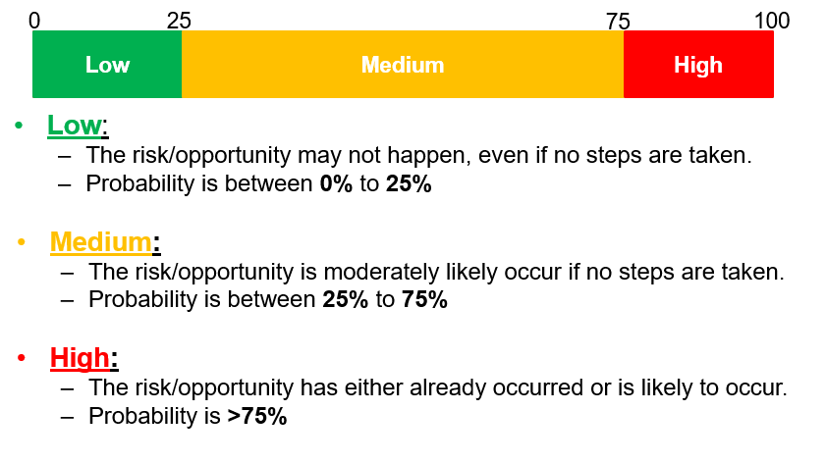
Risk Probabilities

Slide 8
Risk Impacts
Impact Area | Low | Medium | High
Schedule | Impact on schedule will be only of non-critical tasks. Project expected to complete on time. | Critical tasks will slip, but can be recovered by 'tweaking' the plan. Current estimation is completion 10% later than expected. | Slippage of key dates – cannot be recovered without major re-planning. Completion estimation is >10% later than expected.
Budget | No Impact (overrun can be absorbed elsewhere) | Project budget overrun <10% | Project budget overrun >10%
People | Project fully resourced | Under resourced by <=1 FTE | Under resourced by >1 FTE
Scope | Will deliver agreed upon scope | At risk to deliver the agreed upon scope | Will not be able to deliver agreed upon scope
Overall success | No significant impact | Chance of project success is reduced, but still at an acceptable level | Risk of failure on the project is unacceptably high

Slide 9
Risk Exposure
 |  |  | Impact
 |  |  | Low | Med | High
Probability | Low | The +/- risk may not happen, even if no steps are taken. Probability between 0% to 25%. | Low | Low | Medium
 | Med | The +/- risk is moderately likely occur if no steps are taken. Probability between 25% to 75%. | Low | Medium | High
 | High | The +/- risk has either already occurred or is likely to occur. Probability >75%. | Medium | High | High

