Slide 1
Greening Backbone Networks Shutting Off Cables in Bundled Links
Will Fisher, Martin Suchara,
and Jennifer Rexford
Princeton University

Slide 2
Why Focus on Networks?
Saving energy in servers vs. networks
Potential for savings in wired networks
$2 billion annual power bill in USA alone
Over-engineering and diurnal patterns
Power draw does not scale with load

Slide 3
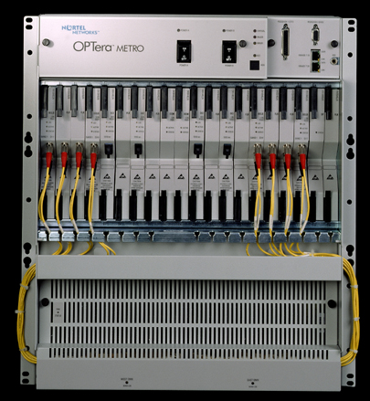
Power Consumption of Network Hardware
Router may consume 200 - 400W plus 100 W per line card
Power draw does not scale with load
chassis
line card

Slide 4
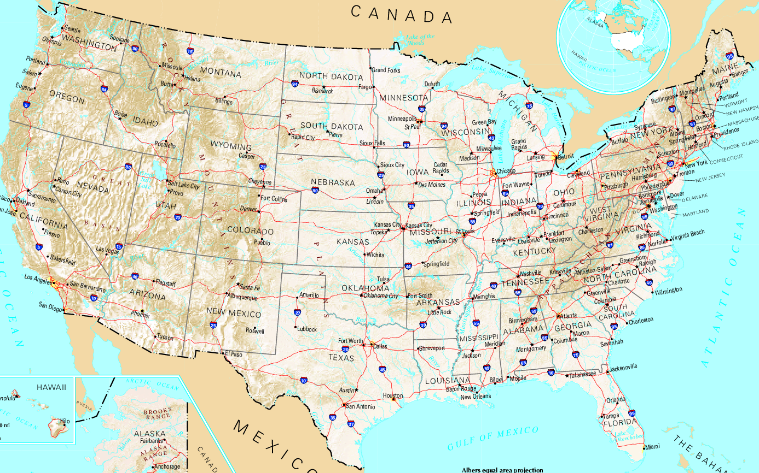
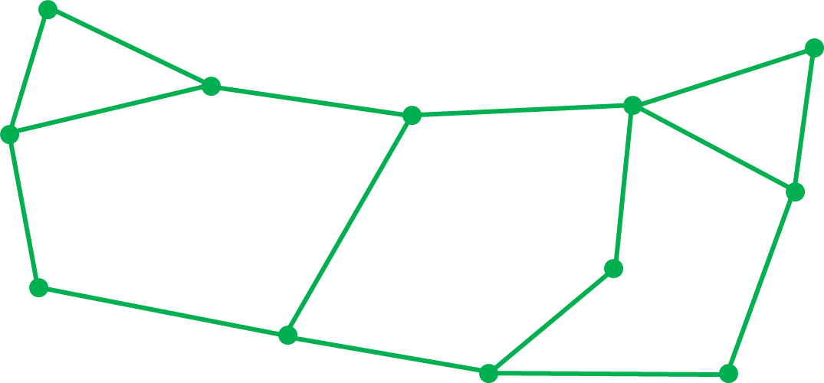
Turn Off Unneeded Routers / Links?
Turning off links has drawbacks
Increased RTT, fragility, etc.

Slide 5
Links in Large Backbone Networks
Links come in bundles
Gradual upgrades, hardware costs, etc.
City A
City B

Slide 6
Links in Large Backbone Networks
Links come in bundles
Gradual upgrades, hardware costs, etc.
Bundled link behaves as a single logical link
In large networks
Majority of links bundled
Bundle sizes 2 – 20 cables per link

Slide 7
The Problem…
Powering all cables is wasteful
City A
City B
30-40% utilization

Slide 8
Proposed Solution
Only power up cables that are needed
Transparent to routing protocols
City A
City B
80% utilization

Slide 9
Overview
Optimization problem formulation & solution
Experimental evaluation of energy savings
Conclusion

Slide 10
The Problem
Algorithm used by network operators
Input: network configuration and load
Output: list of powered cables
Integer linear program:
min # powered cables
s.t. link loads ≤ capacities
flow conservation
carries all traffic demands
NP-hard in general → need heuristics

Slide 11
Related Tractable Problem
How would the solution look like if energy consumption was proportional to link load
Minimize sum of link loads rather than the number of powered cables
Fractional vs. integer linear program
Benefits: tractable, provides upper and lower bound on potential power saving, starting point for heuristics

Slide 12
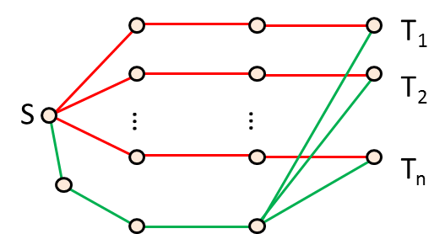
First Attempt – Naïve Solution
Always round up:
→
Up to n times worse performance where n ≈ number of cities

Slide 13
Three Increasingly Sophisticated Heuristics
Start with the naïve solution and perform local search
Fast Greedy Heuristic (FGH)
Exhaustive Greedy Heuristic (EGH)
Bi-level Greedy Heuristic (BGH)

Slide 14
The Fast Greedy Heuristic (FGH)
1. solve the fractional linear program
and round up
2. identify link with greatest
rounding up
3. round down by permanently removing
one more cable in that link
→
4. goto step 1 if feasible solution
exists

Slide 15
Overview
Optimization problem formulation & solution
Experimental evaluation of energy savings
Conclusion

Slide 16
Experimental Setup
Determine energy savings and ability to run algorithms in real time
Solve the simple linear program using AMPL / CPLEX
Experiments repeated for bundle sizes 1 to 12

Slide 17
Topologies
Abilene with real measured traffic demands
Waxman and hierarchical topologies

Slide 18
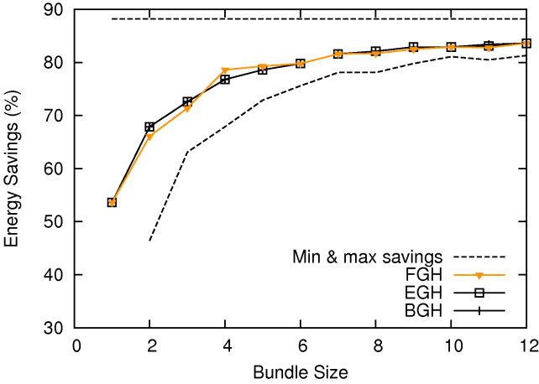
Energy Savings– Abilene Topology
Similar performance of heuristics
energy savings (%)
Turn entire link on or off
bundle size
Energy savings depend on the bundle size.

Slide 19
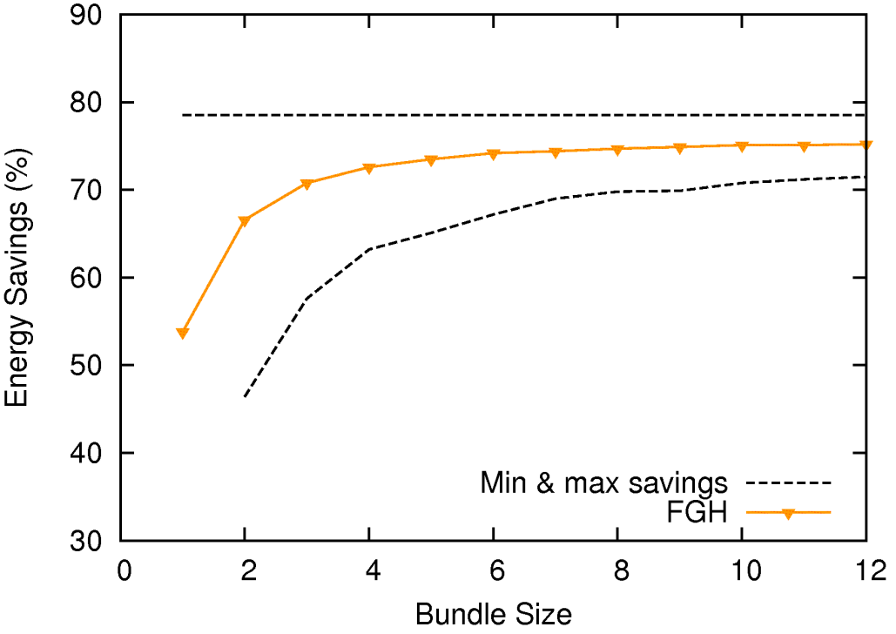
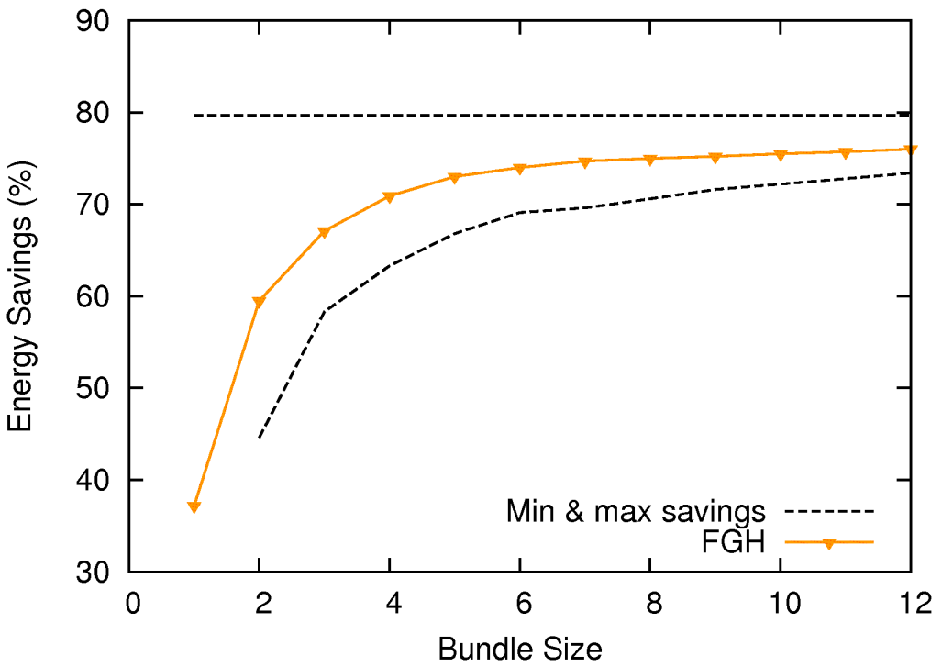
Waxman and Hierarchical Graphs
Turn entire link on or off
The same general trend

Slide 20
Execution Time
Topology | FGH | EGH | BGH
Abilene | 8 sec | 50 sec | 5 min
Large synthetic | minutes | minutes to hours
FGH is well suited for real-time execution

Slide 21
Overview
Optimization problem formulation & solution
Experimental evaluation of energy savings
Conclusion

Slide 22
Conclusion
Powering all links in a bundle usually not needed
Design and evaluation of simple heuristics
Significant energy savings
Low computational complexity
Can choose the simplest heuristic (FGH)

Slide 23
Thank You!

