Slide 1

Hybrid Quantum-Classical Computing Architectures
Intel Invited Talk Series
February 28, 2019
erhtjhtyhy
Martin Suchara
Yuri Alexeev*, Frederic Chong†, Hal Finkel*, Henry Hoffmann†, Jeffrey Larson*, James Osborn*, Graeme Smith§
Argonne National Laboratory
msuchara@anl.gov
* Argonne National Laboratory
† University of Chicago
§ University of Colorado – Boulder

Slide 2
What is Quantum Computing?
New computing paradigm
  Uses the rules of quantum mechanics to manipulate information
  Exponential speedup for some problems: quantum simulation, factoring, quantum walks on graphs, etc.
  Groundbreaking implications in computer security and cryptography
Active research spans topics from quantum algorithms all the way down to device physics
The race to build a quantum computer is now on
2

Slide 3

Storing and Manipulating Classical vs. Quantum Information
Qubit in state where
get 0 with probability
Measuring qubit:
get 1 with probability
Exponential state space increase with number of qubits
3

Slide 4
How a quantum computer works
4

Slide 5
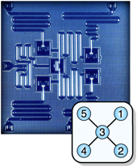
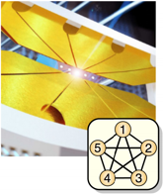
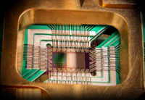

How do Quantum Technologies
Look Like?
Superconducting qubits:
Josephson Junctions between superconducting electrodes
Ion traps:
Ions trapped in electromagnetic field, gates performed by applying lasers
Adiabatic quantum computation:
Lattice of superconducting qubits that arrange themselves to solve an optimization problem
5

Slide 6
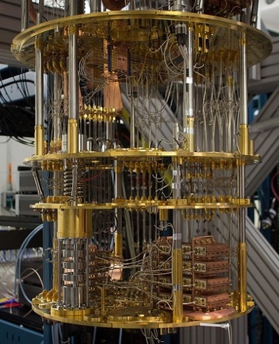
Building Quantum Computers is
Really Hard!
Remarkable technological advances in qubit manufacturing in the past few years but:
  The cost to build quantum processors is extremely high
  It is difficult to add qubits
  Qubit coherence is improving but will always be a fundamental challenge
How can we use (multiple) unreliable quantum processors of intermediate size to reliably solve large computational problems?
IBM Q superconducting quantum computer

Slide 7
What We Want – Use Small Quantum Processors to Solve Large Problems

Slide 8
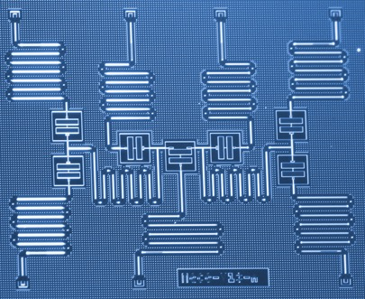
Idea: Cut a Large Quantum Circuit Into Multiple sub-Circuits
Original quantum circuit:
Evaluate this circuit on a device with 7 qubits?
8

Slide 9
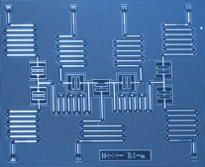
Idea: Cut a Large Quantum Circuit Into Multiple sub-Circuits
Processor A
Cost scales exponentially with number of wire and gate cuts
Need to find a clean cut
Bravyi, Smith, Smolin, Phys. Rev. X, 2016
Harrow, Ozols et al., Semantic Scholar and private communication
Processor B
9

Slide 10
Idea: Cut a Large Quantum Circuit Into Multiple sub-Circuits
Original circuit
10

Slide 11
Idea: Cut a Large Quantum Circuit Into Multiple sub-Circuits
Original circuit
11

Slide 12



Idea: Cut a Large Quantum Circuit Into Multiple sub-Circuits
Original circuit
12

Slide 13
Idea: Cut a Large Quantum Circuit Into Multiple sub-Circuits
Original circuit
Fragment A
Fragment B
13

Slide 14
Combining the Outputs with Classical Postprocessing
Repeatedly run each circuit, perform measurements in the X, Y and Z bases, and record the measurement outcomes
Fragment B
Fragment A
X
Y
Z
The probabilities you expect:
Outcome
0 0 0 | 0.25 | 0.25 | 0.5
0 1 0 | 0.25 | 0.25 | 0
1 0 1 | 0.25 | 0.25 | 0
1 1 1 | 0.25 | 0.25 | 0.5
X
Y
Z
Outcome
0 | 0.5 | 0.5 | 0
1 | 0.5 | 0.5 | 1
14

Slide 15
Combining the Outputs with Classical Postprocessing
Repeatedly run each circuit, perform measurements in the X, Y and Z bases, and record the measurement outcomes
Fragment B
Fragment A
X
Y
Z
Results with a quantum simulator:
Outcome
0 0 0 | 0.25 | 0.27 | 0.5
0 1 0 | 0.26 | 0.25 | 0
1 0 1 | 0.24 | 0.25 | 0
1 1 1 | 0.25 | 0.23 | 0.5
X
Y
Z
Outcome
0 | 0.49 | 0.49 | 0
1 | 0.51 | 0.51 | 1
15

Slide 16
Combining the Outputs with Classical Postprocessing
Repeatedly run each circuit, perform measurements in the X, Y and Z bases, and record the measurement outcomes
Fragment B
Fragment A
X
Y
Z
Results on a 16-qubit IBM Q processor:
Outcome
0 0 0 | 0.30 | 0.30 | 0.37
0 1 0 | 0.19 | 0.20 | 0.05
1 0 1 | 0.16 | 0.17 | 0.10
1 1 1 | 0.20 | 0.20 | 0.27
X
Y
Z
Outcome
0 | 0.52 | 0.56 | 0.05
1 | 0.48 | 0.44 | 0.95
16

Slide 17
Combining the Outputs with Classical Postprocessing
Finally we combine the results using multiplicative factors from Harrow et al.:
X
Y
Z
X
Y
Z
Expected circuit output: |11⟩
Outcome
0 | 0.49 | 0.49 | 0
1 | 0.51 | 0.51 | 1
Outcome
0 0 0 | 0.25 | 0.27 | 0.5
0 1 0 | 0.26 | 0.25 | 0
1 0 1 | 0.24 | 0.25 | 0
1 1 1 | 0.25 | 0.23 | 0.5
Outcome | Estimate
0 0 | 0.001
0 1 | 0.000
1 0 | 0.000
1 1 | 0.999
*1 if same, *-1 if different
*-1 if same, *1 if different
*2 if same, *0 if different
17

Slide 18
Quantum Circuit Evaluations with
Intel-QS on Theta Supercomputer
Intel-QS is a freely available quantum simulator: https://github.com/intel/Intel-QS
Code was ported and optimized for Cray/Intel supercomputer Theta at Argonne
Simulator takes advantage of multi-core and multi-node architectures, parallelization with MPI and OpenMP
State space increases exponentially with number of qubits
Qubits | Memory (GB) | Theta Nodes | Gate Time (sec)
35 | 788 | 512 | 458
40 | 25,216 | 16,098 | 796
45 | 806,912 | 515,136 | 1,632
18

Slide 19
Quantum Chemistry Circuit Evaluation
With Intel-QS on Theta Supercomputer
Time to solution for a 30 gate circuit running on 30 qubits; 1 to 64 threads for 1 MPI rank shown
Scales up to 32 threads
Time to solution for a 35-qubit simulation with a single gate per qubit
MPI rank varies from 1 to 4,096 with 64 OpenMP threads per rank
19

Slide 20
Weak Scaling with number of qubits and Gate Depth - Intel-QS on Theta
Gates | Time (sec)
2 | 563
4 | 1,068
10 | 645
501 | 1,050
100 | 2,028
200 | 3,089
400 | ~86,400 (est.)
Time to solution vs. number of Theta nodes as the number of qubits increases
Simple circuit: Hadamard gate on all qubits
Estimating the number of gates that can be run in 24 hours (maximum time in queue)
20

Slide 21
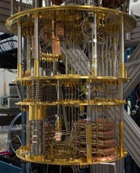
Summary: Hybrid Quantum-Classical Computing Approach
Can use quantum processors to evaluate circuit fragments with 20 to 50 qubits and gate depth ~100
Circuits must be cleanly separable
Exponential cost depends on number of gate cuts
Intel-QS can simulate circuits with 35 to 45 qubits and gate depth up to ~400
Allows accurate circuit evaluation without introducing noise
Soon quantum supremacy may be achieved for some circuits
21

Slide 22
Thank you!

