Slide 1
Topological Subsystem Codes with Local Gauge Group Generators
Martin Suchara
in collaboration with:
Sergey Bravyi and
Barbara Terhal

Slide 2
Quantum Error Correction (QEC)
Need error correction to build a practical quantum computer
Reliable quantum information storage and computation with unreliable components
Much more challenging than classically
Analog nature of quantum operations
New kinds of errors: partial bit flips, phase flips, small shifts

Slide 3
Some Milestones in QEC Research
Quantum block error correcting codes (Shor, 1995)
Threshold theorem (Knill et al., 1998)
Topological quantum codes (Kitaev, 1997)
Subsystem codes (Poulin, 2005 and Bacon, 2006)

Slide 4
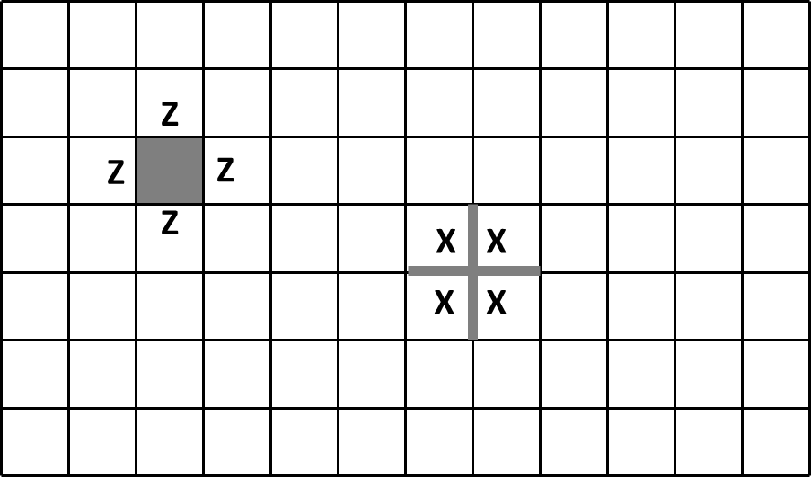
Example – Topological Quantum Memory
Qubits on links (or sites) in the lattice
Measuring these “check” operators yields error syndromes

Slide 5
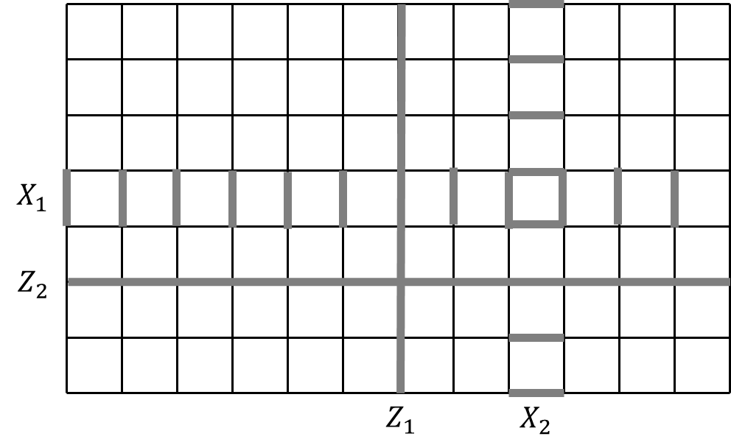
Example – Topological Quantum Memory
Logical operators

Slide 6
Advantages of Topological Stabilizer Codes
Qubits laid on two-dimensional grid
Local syndrome measurements
Can increase lattice size rather than concatenate smaller blocks
High threshold
Permit encoding of multiple qubits and implementation of some gates by code deformation

Slide 7
Error Correction with 2-Body Measurements (Bombin 2010)
Earlier codes: measurements of at least four neighboring qubits
Our code: only local two-qubit measurements
Simplifies physical implementation
Main questions
How should the lattice look like?
How should the decoding algorithm work?
Numerical value of the threshold?

Slide 8
Overview
Construction of topological subsystem codes
The five-squares code
Experimental evaluation of the threshold
Conclusion

Slide 9
Error Correcting Codes
Codespace is a subspace of a larger Hilbert space that encodes logical information
Syndrome measurements diagnose errors
Decoding algorithm returns system to the original logical state
Threshold: below some noise level error correction succeeds w. h. p.

Slide 10
Stabilizer Subsystem Codes
Stabilizer codes characterized by the stabilizer group generated by
Have dimensional codespace:
logical operators
In subsystem codes some “logical” qubits do not encode any information
Can simplify decoding
Characterized by gauge group: stabilizers + logicals acting on gauge qubits

Slide 11
Desired Code Properties
Syndromes can be extracted by measuring two-qubit gauge operators
Topological properties of the code: stabilizer group has spatially local generators
At least one logical qubit encoded

Slide 12
Kitaev’s Honeycomb Model on a Torus
Link operators XX, YY, and ZZ
Anticommute iff share
one endpoint
XX-link
YY-link
ZZ-link
Has spatially local stabilizer
generators (loop operators)
Two-qubit measurements determine syndromes
All loop operators commute
Does not encode any logical qubits!

Slide 13
Generalizing the 3-Valent Lattice
Links connecting three sites – “triangles”
Loop has an even number of incident links at each site
Loop operators anticommute iff they share odd number of triangles
ZY
ZX
ZX
ZY
ZX
ZY
ZZZ-link
XY-link
ZZ-link

Slide 14
Generalizing the 3-Valent Lattice
Links connecting three sites – “triangles”
Loop has an even number of incident links at each site
Loop operators anticommute iff they share odd number of triangles
ZY
ZX
ZX
ZY
ZZZ-link
XY-link
ZZ-link
ZY
ZX

Slide 15
Generalizing the 3-Valent Lattice
Links connecting three sites – “triangles”
Loop has an even number of incident links at each site
Loop operators anticommute iff they share odd number of triangles
Intersecting loops anticommute at 3 sites
X/Y
X/Y
Y/X
ZZZ-link
XY-link
ZZ-link

Slide 16
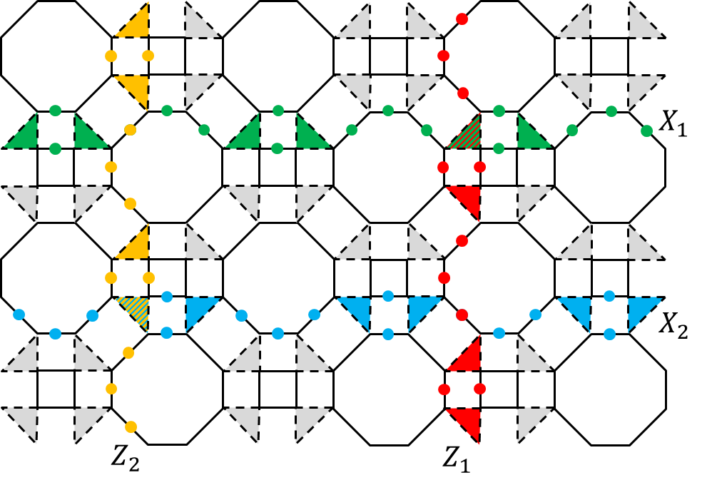
The Square-Octagonal Lattice The Logical Operators

Slide 17
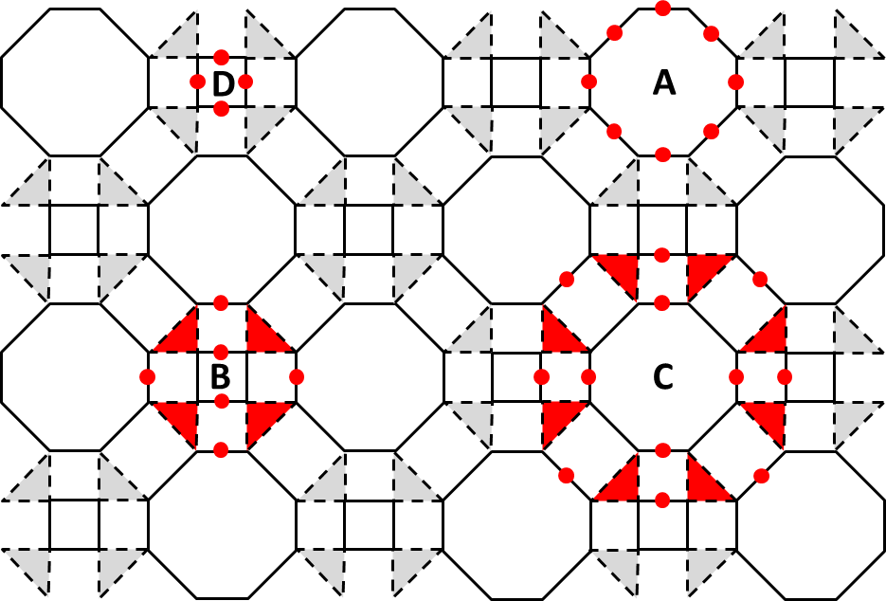
The Square-Octagonal Lattice The Stabilizers

Slide 18
The Gauge Group Generators
Link operators of weight two:
X
Y
X
Y
X
Y
Y
Y
X
X
Each triangle gives rise to a triple of generators:
Z
Z
Z
Z
Z
Z

Slide 19
Overview
Construction of topological subsystem codes
The five-squares code
Experimental evaluation of the threshold
Conclusion

Slide 20
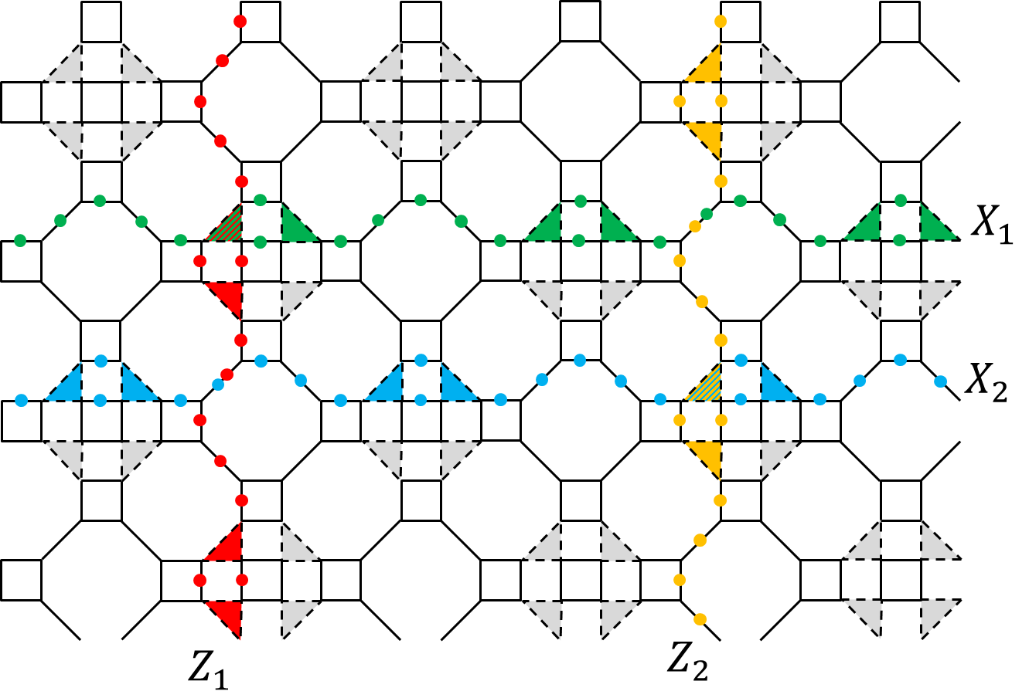
The Five-Squares Lattice The Logical Operators

Slide 21
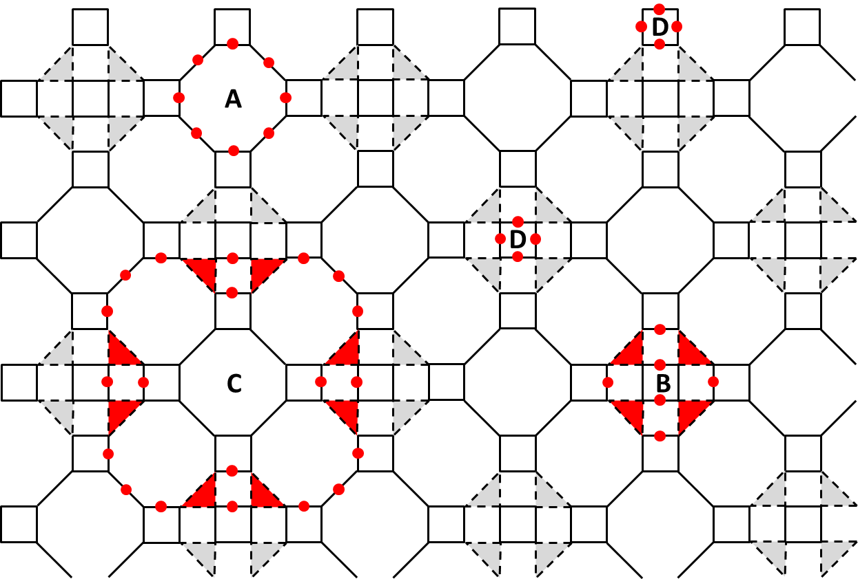
Examples of Lattices (with Stabilizers) Five-Squares Lattice

Slide 22
The Gauge Group Generators
Solid XY-links in squares, and ZZ-links connecting squares:
Z
X
Y
X
Y
Z
Y
Y
X
X
Triangles:
Z
Z
Z
Z
Z
Z

Slide 23
The Stabilizers
A
C
X
Y
X
Y
X
Y
X
Y
Y
X
Y
Y
X
X
X
Y
X
Y
Y
X
Y
X
Y
X
X
Y
X
Y
Y
X
X
X
Y
Y
B
Y
X
Y
X
Y
X
X
Y
Y
Y
X
X
X
X
Y
Y
Z
Z
Y
X
D
Z
Z
How to measure them?

Slide 24
Measuring the Stabilizers
To measure syndromes A, B, C, D need to take 8, 10, 40, and 4 two-qubit measurements
B
B
X
Y
YZ
XZ
Y
X
XZ
YZ
Y
X
Y
X
X
Y
X
Y
X
Y
YZ
XZ
Y
X
XZ
YZ

Slide 25
The Stabilizers
A
C
X
Y
X
Y
X
Y
X
Y
Y
X
Y
Y
X
X
X
Y
X
Y
Y
X
Y
X
Y
X
X
Y
X
Y
Y
X
X
X
Y
Y
B
Y
X
Y
X
Y
X
X
Y
Y
Y
X
X
X
X
Y
Y
Z
Z
Y
X
D
Z
Z
How to use them to correct errors? Correct X and Z errors separately.

Slide 26
Correcting X Errors
Consider an arbitrary X error:
X
X
XY = iZ
X
XY = iZ
XY = iZ
1
2
Only need to correct errors X₁, X₅, X₉, X₁₃, and X₁₇.
4
3
5
6
9
10
13
14
8
7
12
11
16
15
Easy to do with syndrome
17
18
Z
Z
20
19
Z
Z

Slide 27
Correcting Z Errors
1
2
Similarly, only need to consider Z₁, Z₂, Z₄, Z₁₉, and Z₂₀.
4
3
5
6
9
10
13
14
8
7
12
11
16
15
17
18
And Z₄ is corrected using stabilizer B
B
20
X
Y
19
Y
Y
X
X
X
X
Y
Y
Y
X
How do the remaining stabilizers act on the errors?

Slide 28
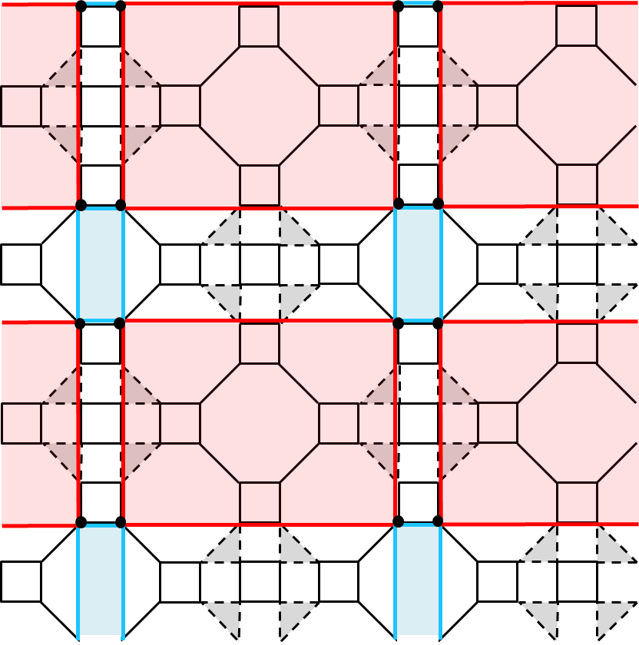
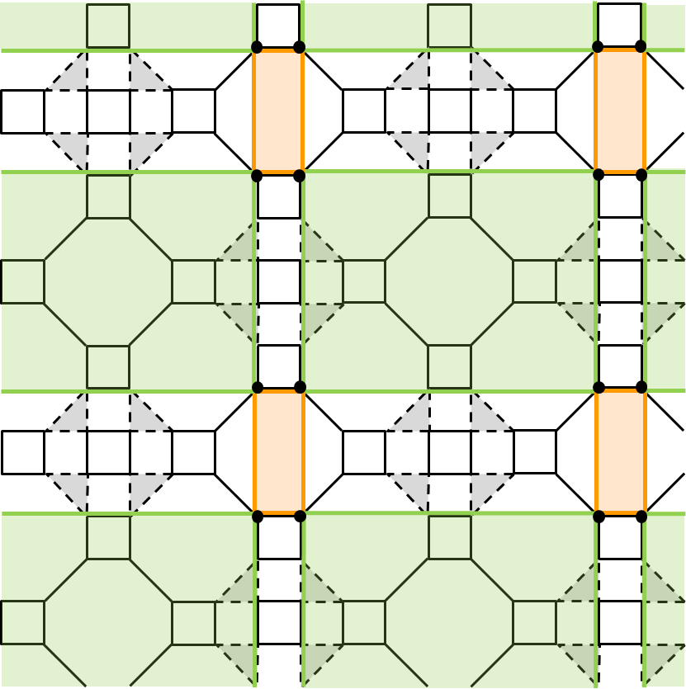
Correcting Z Errors
Potential Z errors
Potential Z errors
Potential Z errors
Potential Z errors
Two non-overlapping sublattices

Slide 29
Correcting Z Errors
Potential error locations highlighted
Two types of stabilizers (A and C)
Two types of stabilizers

Slide 30
Correcting Z Errors
Find the smallest possible weight error
Minimum weight matching algorithm
Match pairs of non-trivial syndromes
Minimize total weight of the matching
Correct Z errors on lines connecting matched syndromes
Error correction fails if E_{actual}E_{guessed} is a logical operator

Slide 31
Overview
Construction of topological subsystem codes
The five-squares code
Experimental evaluation of the threshold
Conclusion

Slide 32
Assumptions and Experimental Setup
Depolarizing error model
X, Y and Z errors with probability p/3
Noiseless syndrome measurements
Monte Carlo simulation in C++
640 to 40,960 qubits
Generate and correct random error
Repeat 1,000 times

Slide 33
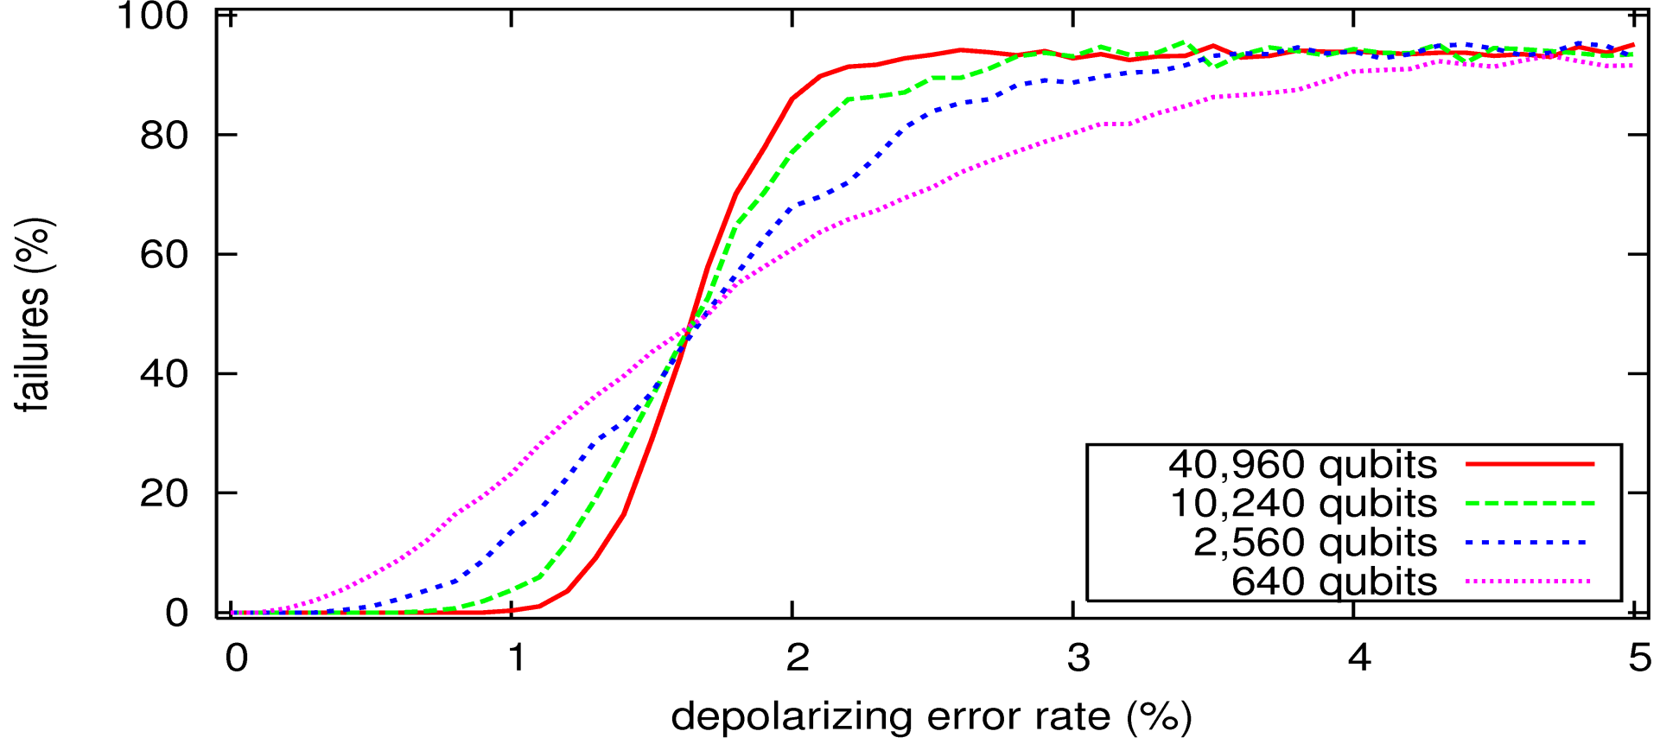
Threshold – Simple Decoding Algorithm
storage threshold
~ 1.5%
Transition sharper for larger lattice size

Slide 34
Improving the Threshold
In the first two correction steps guess the smallest weight error!
Original X error locations
Syndrome B does not change
Syndrome B changes
1
2
1
2
1
2
4
3
4
3
4
3
5
6
9
10
13
14
5
6
9
10
13
14
5
6
9
10
13
14
8
7
12
11
16
15
8
7
12
11
16
15
8
7
12
11
16
15
17
18
17
18
17
18
20
19
20
19
20
19

Slide 35
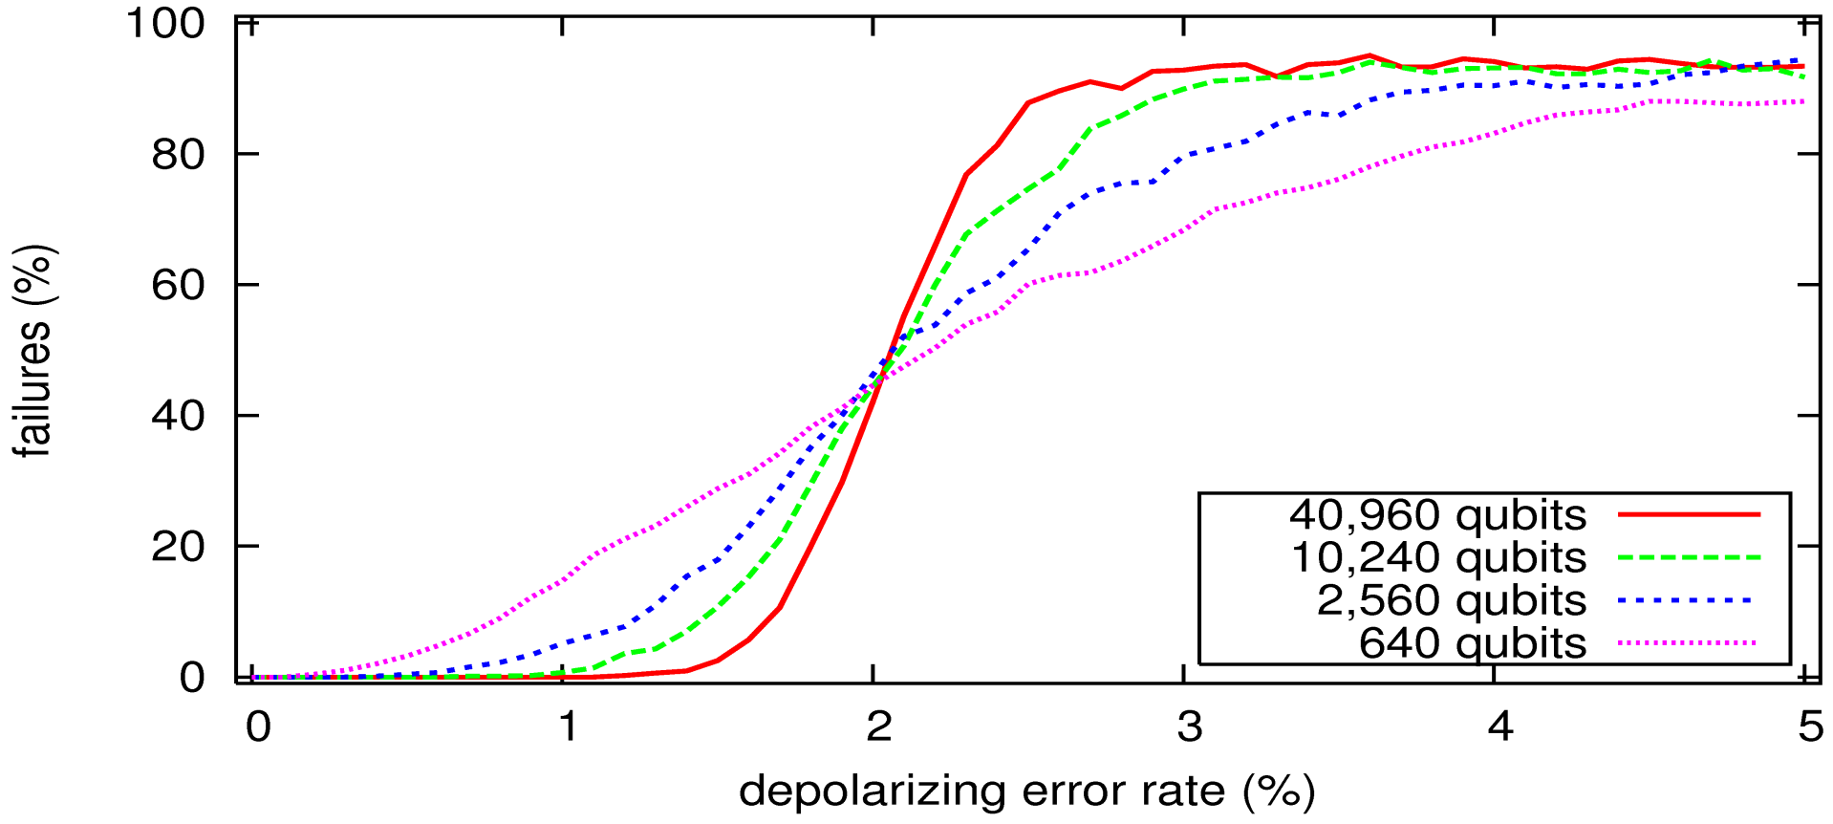
Threshold – Improved Decoding
storage threshold
~ 2%
Noticeable improvement of threshold

Slide 36
Overview
Construction of topological subsystem codes
The five-squares code
Experimental evaluation of the threshold
Conclusion

Slide 37
Conclusion
Construction of new codes that only require two-qubit measurements for error correction
Decoder for the five-squares code achieves 2% storage threshold
Price to pay: threshold value and number of measurements needed for syndrome calculation
Open question: how to encode multiple logical qubits by creating holes?

Slide 38
Thank You!

