Slide 1
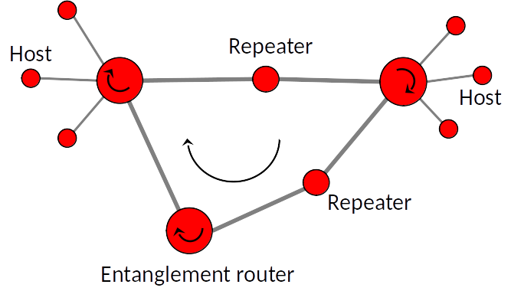
Simulation-Driven Design of Photonic Quantum Communication Networks
erhtjhtyhy
Martin Suchara
Work with Xiaoliang Wu, Joaquin Chung, Alexander Kolar, Eugene Wang, Tian Zhong, and Rajkumar Kettimuthu
Argonne National Laboratory
msuchara@anl.gov
November 18, 2019
SC19, Denver, CO

Slide 2
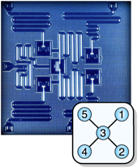
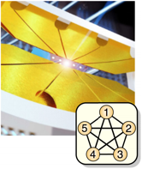
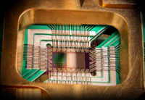

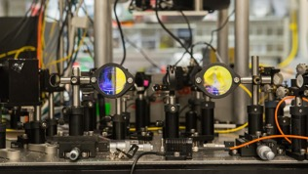


Quantum Computing and Communication
Classical bit: | Qubit: | Multi-qubit systems:
|0⟩
𝛼|0⟩ + β|1⟩
2 qubits: 𝛼|00⟩ + β|01⟩ + 𝛾|10⟩ + 𝛿|11⟩
$0$
3 qubits: 𝛼|000⟩ + β|001⟩ + 𝛾|010⟩ + 𝛿|011⟩ + 𝜀|100⟩ + 𝜁|101⟩ + 𝜂|110⟩ + 𝜃|111⟩
$1$
|1⟩
Secure communication and teleportation:

Slide 3



BB84 Protocol – Bennett & Brassard, 1984
Eve
Alice
Bob
polarization filter
detection filter
unpolarized photon
transmitted polarized photons
detection filter
laser
Step 1 | Alice’s bit | 0 | 1 | 1 | 0 | 1 | 0 | 0 | 1 | 0
Step 2 | Alice’s random basis | + | + | x | + | x | x | x | + | +
Step 3 | Alice’s polarization | → | ↑ | ↖︎ | → | ↖︎ | ↗︎ | ↗︎ | ↑ | →
Step 4 | Bob’s random basis | + | x | x | x | + | x | + | + | x
Step 5 | Bob’s measurement | → | ↗ | ↖︎ | ↗︎ | ↑ | ↗︎ | ↑ | ↑ | ↗︎
Step 6 | Public discussion | Determine which bases match and only retain the corresponding bits
Step 7 | Shared secret key | 0 |  | 1 |  |  | 0 |  | 1

Slide 4
Quantum Teleportation Networks
Teleportation of quantum state |𝜓⟩ from Alice to Bob using a quantum channel (QC) and a classical channel (CC)
Quantum communication does not require a quantum channel between Alice and Bob

Slide 5
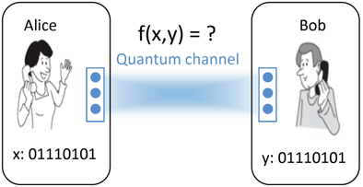
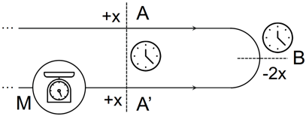
New Quantum Network Applications
clock synchronization
quantum sensing
distributed computing
Heterogeneous applications – each with different specialized function
Bandwidth, latency and security requirements vary
Many applications require long-distance communication
Challenge as well as opportunity
quantum key distribution

Slide 6
Simulations of Quantum Networks
Quantum Network Simulation Team

Slide 7
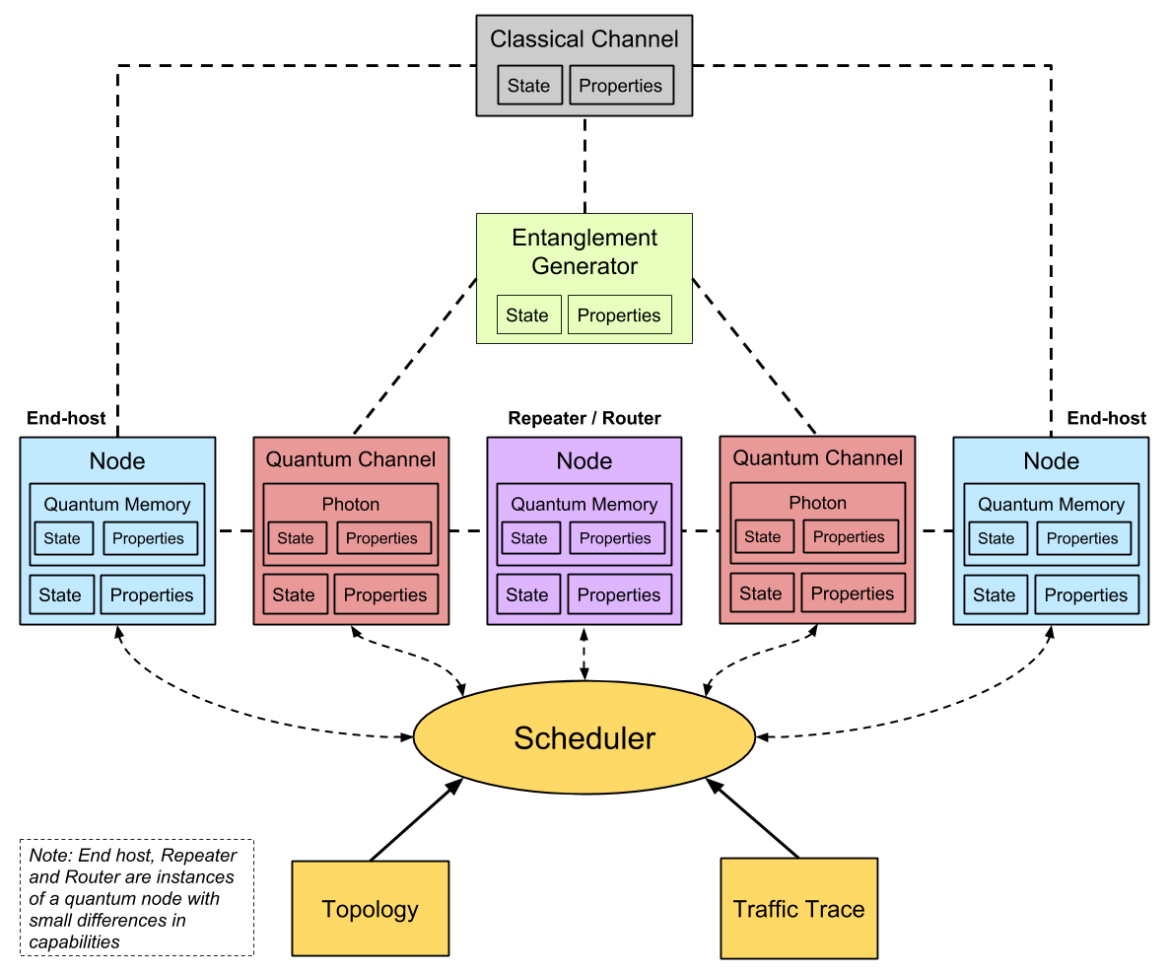
Simulator of quantum network communication (Sequence)
Modularized discrete event simulator with a scheduler and entanglement manager
Simulates quantum communication at photon-level with picosecond accuracy
Models of light sources, SPDCs, quantum and classical channels, single photon detectors, beam splitters, interferometers, BSMs
Simulations with different parameters, protocols, topologies, and network architectures
7

Slide 8
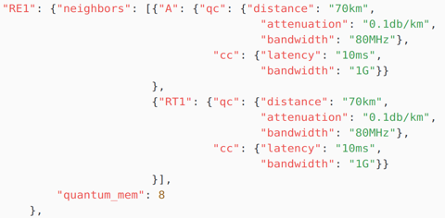
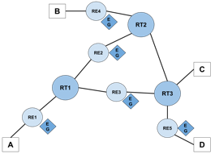
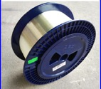
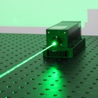
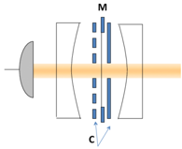
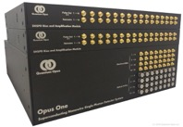
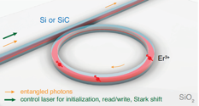
Specifying Parameters of a Simulation
Network topology specification:
Properties of optical components:
Choose quantum network protocols from a library:
8

Slide 9
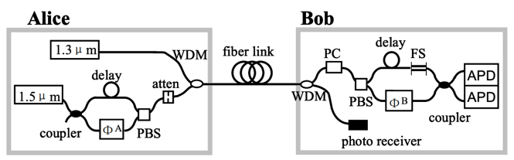
Simulating Quantum Key Distribution
Original experimental setup:
Gobby et al., “Quantum key distribution over 122 km of standard telecom fiber”
Our simulation setup:
Implements BB84 and CASCADE with time-bin encoded qubits
Simplified models of optical components
Tracks individual photons with picosecond accuracy
9

Slide 10
Simulations to Validate or Predict Experimental Results
Simulation of BB84 protocol with time bin encoding transmitting 256-bit keys
Careful modeling and validation against experiments is important
Must be done in collaboration with experimental groups
Measured rate after inclusion of phase modulator error
Measured rate
Theoretical rate
10

Slide 11
Simulations to Validate or Predict Experimental Results
The raw bit rate (throughput of BB84) and the key formation rate (throughput of the Cascade protocol) decrease exponentially with increasing distance
Cascade suffers from large latency due to the need to construct a 10,240-bit frame before error correction can begin
Use of light source with higher frequencies dramatically improves latency
11

Slide 12
Simulating quantum teleportation
Calgary experiment:
Valivarthi et al., “Quantum teleportation across a metropolitan fibre network”
Our simulation setup:

Slide 13
Results – Teleportation simulation
Z-basis measurement by Bob:
X-basis measurement by Bob:
Lower fidelity for X-basis measurement due to errors in the interferometer and use of two single-photon detectors
13

Slide 14
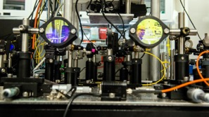
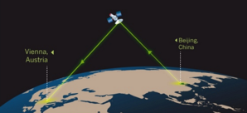
Building the Quantum Internet

Slide 15

Quantum Teleportation at the Chicago quantum exchange
Optical table demonstrating the principles of quantum teleportation in the Awschalom Lab (University of Chicago and Argonne)
Quantum teleportation allows transmission of quantum states between two network hosts (Argonne and Fermilab)

Slide 16
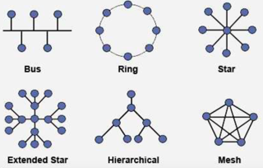
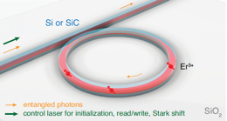
What Are Quantum Network Simulations Useful for?
Network architecture design – topology and architecture that allows scalability and long-distance communication
Experiment planning and validation – facilitate system integration with hundreds of optical components, allow easy parameter tuning, predict and validate results
New protocol and control plane design – evaluate performance of specialized network protocols for e.g. entanglement purification
Motivate experimental advances – what are the benefits of building better detectors, memories, or light sources?

Slide 17
Thank You!

Slide 19
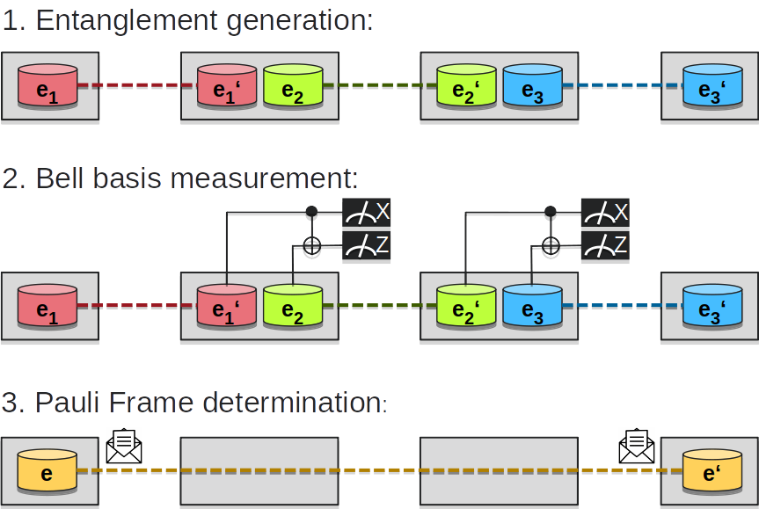
Orchestration - Entanglement swapping
Distribution of entangled photons only between nearest neighbors, or not?
Photons stored in memories until they are consumed
Optional purification techniques to improve fidelity
Requires careful orchestration at the individual photon level!
Different paradigm: need to rethink network architecture
19

Slide 20
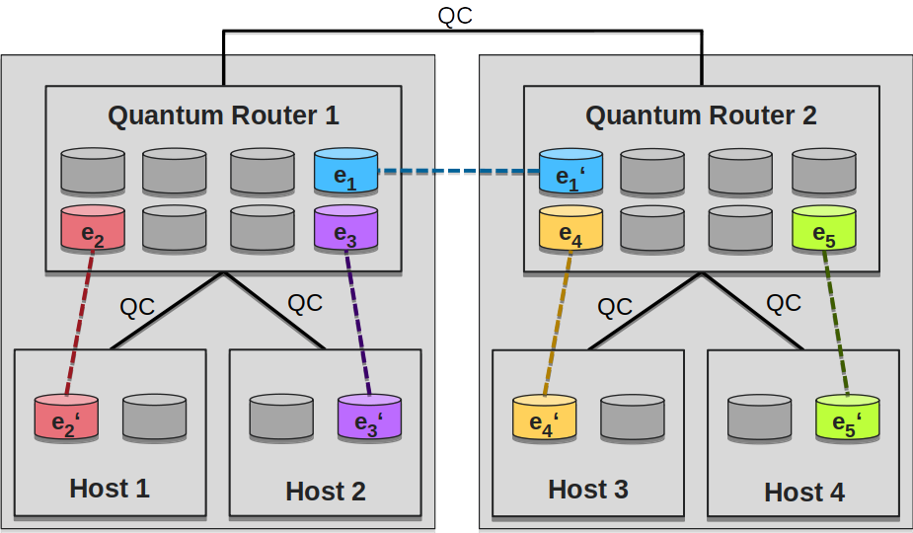
Multi-node Quantum network architecture
Reconfigurable quantum nodes
  Memory, photon pair source, BSM unit
Coherent quantum materials and photonics
  Long coherence memory, classical control of photon
Control plane determines role and action of nodes
Control plane protocols will be needed for networks with 3 or more nodes
20

