Slide 1
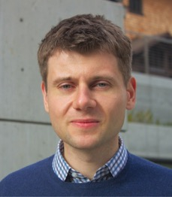
Quantum Information Science
at Argonne National Laboratory
MARTIN SUCHARA
Computational Scientist
Mathematics and Computer Science
msuchara@anl.gov

Slide 2
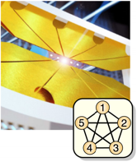
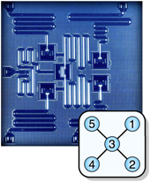
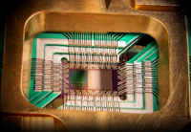

Manipulating and Interconnecting Entanglement
Network engineering & design:
Design architecture and protocols
Understand behavior by simulations
Develop new applications
Reliable quantum computing:
Variational quantum algorithms and their applications
Quantum circuit optimization
Understanding and mitigating noise

Slide 3
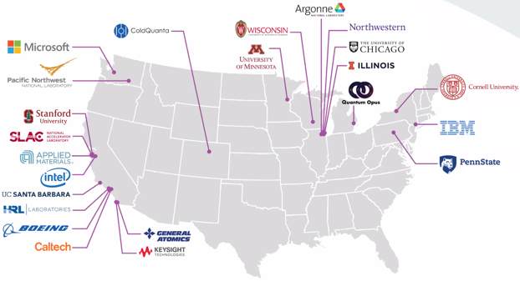
Q-NEXT: Quantum Information Science Research Center at Argonne
Next Generation Quantum Science and Engineering
Major Cross-Cutting Challenge: Manipulating and interconnecting entangled states of matter.
Mission: Deliver quantum interconnects and establish a national resource to provide pristine materials for new quantum devices.
Nearly 100 researchers from 3 national laboratories, 10 universities, and 10 industry partners
$115M from DOE and an additional $93M from industry partners

Slide 4
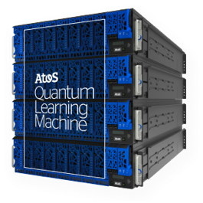
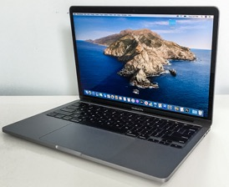
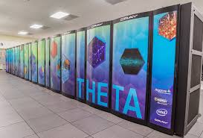
Quantum Simulators and Computing Facilities
Your laptop
Atos QLM-35
Supercomputers at Argonne
Up to 25 qubits
Up to 35 qubits
Up to 60 qubits
ALCF: The Argonne Leadership Computing Facility (ALCF) is a U.S. Department of Energy User Facility located at Argonne National Laboratory. It is the home of Theta (11.69 petaflop system) and from 2021 Aurora, the first US exascale supercomputer.

Slide 5
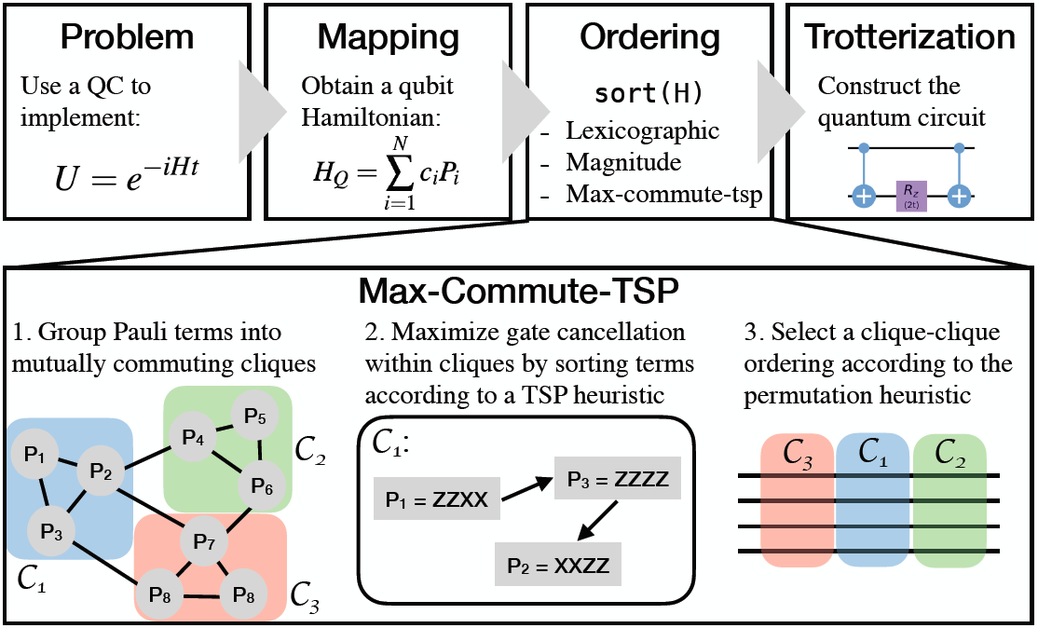
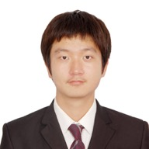
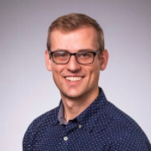
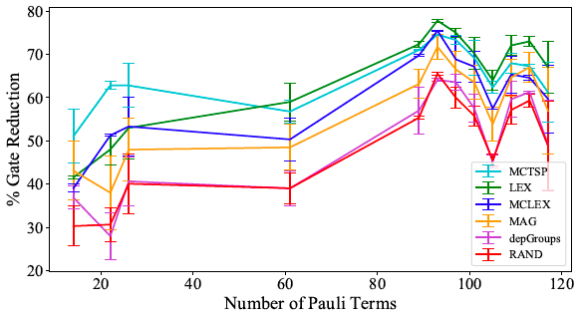
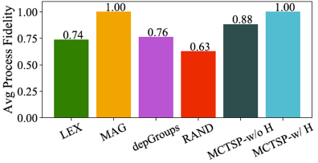
Optimized Quantum Program Scheduling to Mitigate Errors in Quantum Simulations
Kevin Gui
UChicago
Teague Tomesh
Princeton Univ.
Gate cancellations:
Improvements in process fidelity:
5

Slide 6
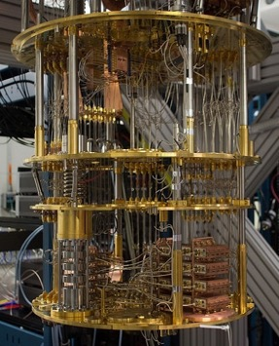
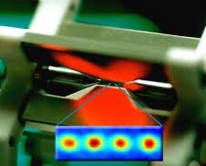
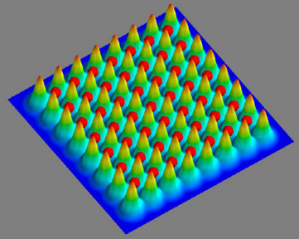
NISQ Computers We Are Using
IBM Q
Linke Lab at UMaryland
ColdQuanta
Technology:
Qubits:
Fidelities:
Superconductors
53 qubits
0.995 / 0.994
Trapped ions
20 qubits
0.991 / 0.97
Neutral atoms
121 qubits
0.992 / 0.89

Slide 7
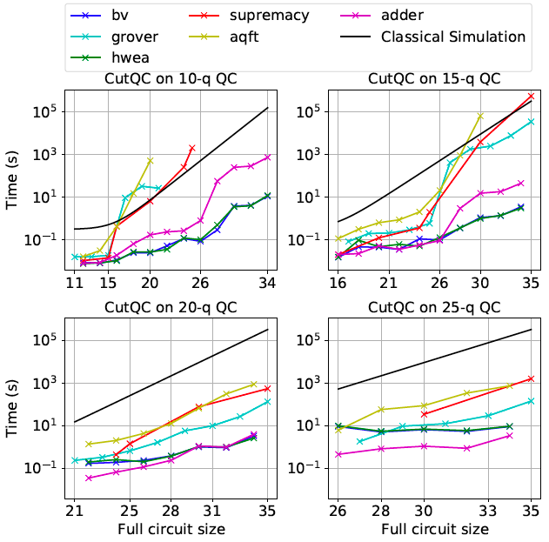
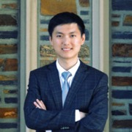
Cutting Large Quantum Circuits Into Multiple sub-Circuits
Addressed exponential scaling with number of wire cuts
Observed favorable impact on overall circuit fidelity
Wei Tang
Summer intern
Up to 35-qubit circuits on 10, 15, 20 and 25 qubit quantum computers
7

Slide 8
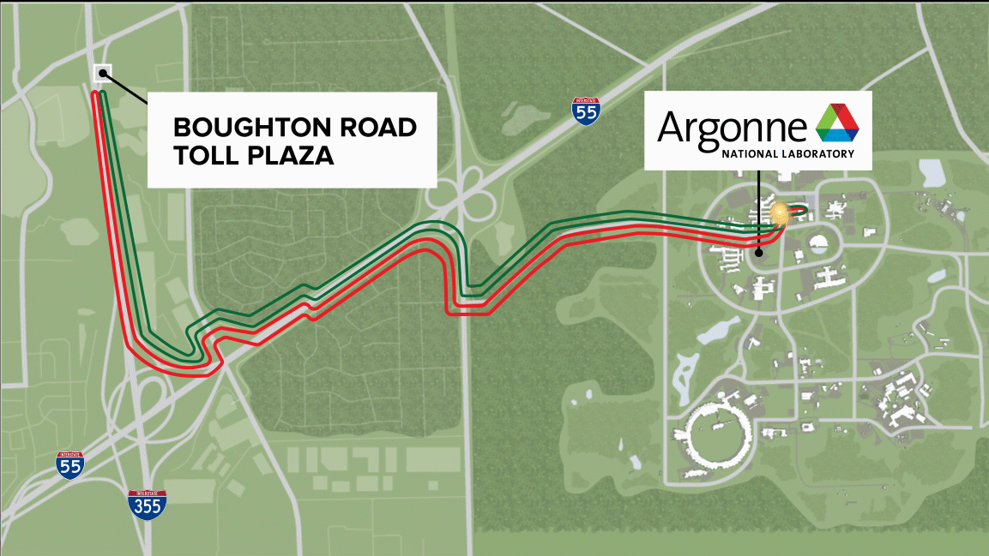
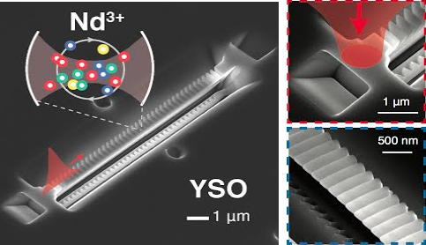
Quantum Networks Research at Argonne National Laboratory and UChicago
Real-world experiment achieves entanglement across 52 miles
Nanophotonic rare-earth quantum memories
Project led by Prof. David Awschalom
Memories in Prof. Tian Zhong’s lab

Slide 9
SeQUeNCe: Simulator of Quantum Network Communication
Modularized discrete event simulator with a scheduler and entanglement manager
Simulates quantum communication at photon-level with picosecond accuracy
Models of different optical components, protocols, and network architectures
Available at https://github.com/ sequence-toolbox/SeQUeNCe
Rajkumar Kettimuthu
Argonne
Tian Zhong UChicago
Martin Suchara
Argonne
Eugene Wang Encore
Xiaoliang Wu
IIT
Alexander Kolar Northwestern
Joaquin Chung Argonne

Slide 10
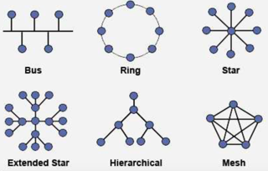
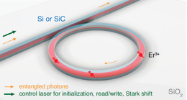
Why Are Quantum Network Simulations Important?
Network architecture design – topology and architecture that allows scalability and long-distance communication
New protocol and control plane design – evaluate performance of specialized network protocols for e.g. entanglement purification
Experiment planning and validation – facilitate system integration with hundreds of optical components, allow easy parameter tuning, predict and validate results
Motivate experimental advances – what are the benefits of building better detectors, memories, or light sources?

Slide 11
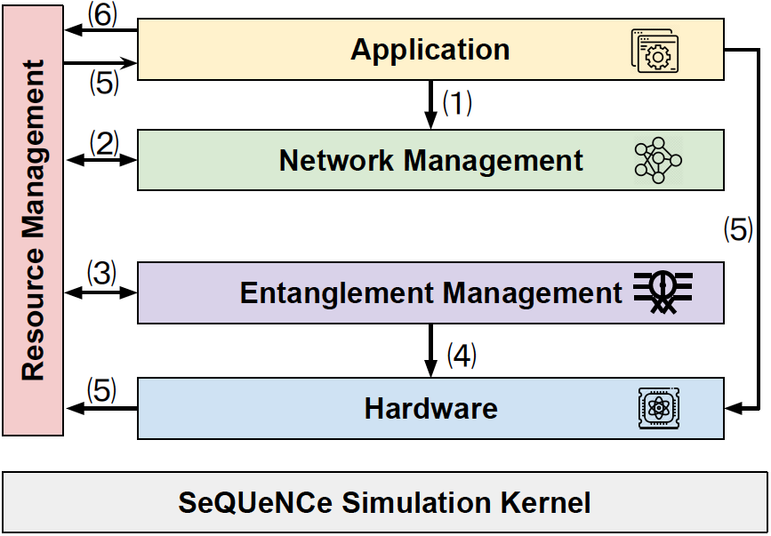
Modularized Design of Sequence
Entanglement transport between end hosts; quantum teleportation; quantum key distribution (BB84 and CASCADE)
Resource reservation for entanglement distribution with target fidelity; routing
Entanglement generation (Barrett-Kok); entanglement purification (BBPSSW); entanglement swapping
Single-atom memories; light sources; SPDCs; quantum and classical channels; SPDs; beam splitters; interferometers; BSMs; etc.

Slide 12
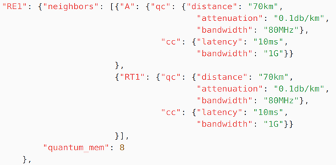
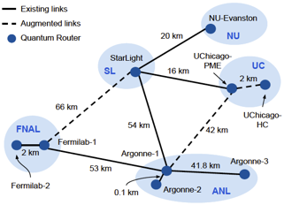
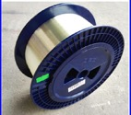
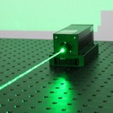
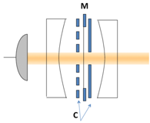
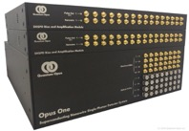
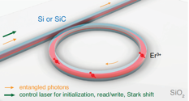
Specifying Parameters of a Simulation
Network topology specification:
Properties of optical components:
Choose quantum network protocols from a library or define new behavior:
12

Slide 13
Simulating Quantum Key Distribution
Quantum key distribution with BB84:
Our simulation setup:
Implements BB84 and CASCADE with time-bin encoded qubits
Simplified models of optical components
Tracks individual photons with picosecond accuracy
13

Slide 14
Simulating quantum teleportation
Simulation setup:

Slide 15
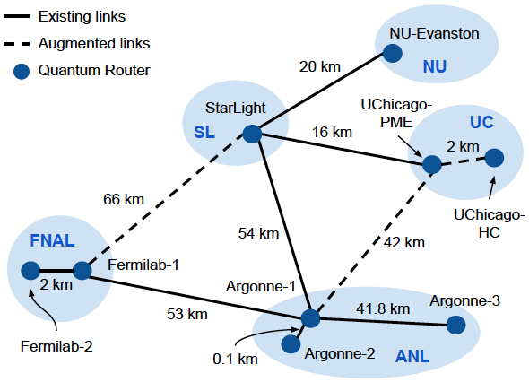
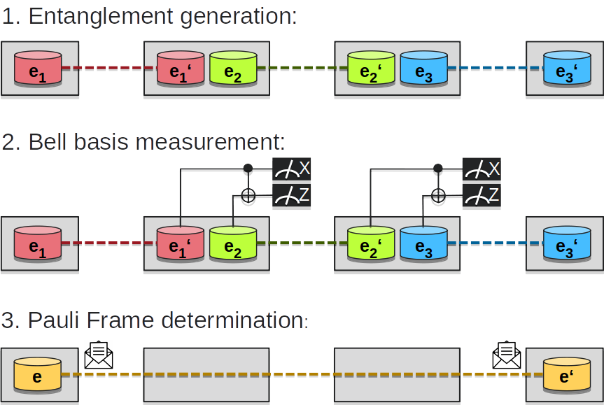
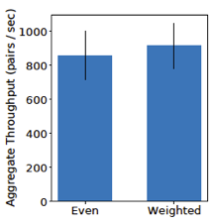
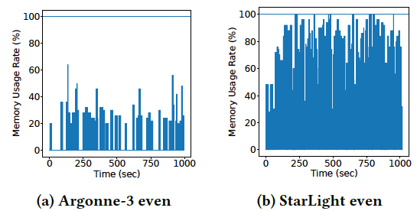
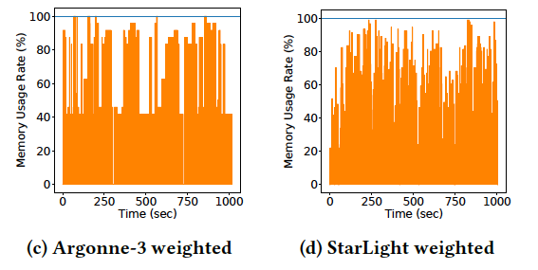
Metropolitan Network With SWAPPING
Chicago Metropolitan Quantum Network:
Entanglement swapping:
Throughput:
Memory usage:

Slide 16
We are hiring. Postdoctoral and PhD student
positions are available. Please contact
Martin Suchara at msuchara@anl.gov.

