Slide 1
Securing Network Infrastructure with Quantum Protocols
erhtjhtyhy
Martin Suchara
Argonne National Laboratory
msuchara@anl.gov
January 15, 2021
QuTCISS

Slide 2
Addressing Security Shortcomings of The TCP/IP Network Control Plane
TCP/IP networks suffer from many security vulnerabilities
Development of the new quantum network control plane allows redesign
Secure protocols at all layers of the stack
Allow easy protocol “upgradability”
Scenario 1: use post-quantum cryptography
Does not require significant changes in the data plane
Key sizes too large for practical use, may lead to degraded performance
No security guarantees, some schemes were broken
Scenario 2: use QKD and QDS protocols
Physical security guarantees
Only solves confidentiality and integrity; vulnerable to availability threats
Quantum digital signatures do not easily generalize to multiparty scenarios

Slide 3
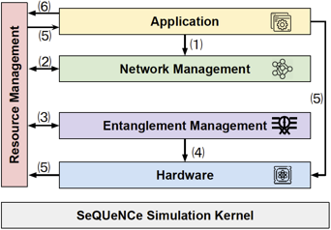
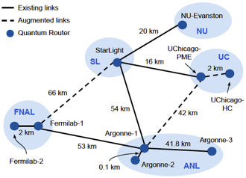
Simulator to Study Network Architecture, Performance, and security
Argonne built Simulator of Quantum Network Communication (SeQUeNCe)
Modularized design corresponds to the layers of the emerging quantum network protocol stack
Implements protocols at all layers
Implemented BB84 and CASCADE with time-bin encoded qubits:
Future directions:
Building secure protocols
E.g. secure routing with quantum position verification
Standardization of quantum network protocols and architectures

