Slide 1
Flow Basics
A Self-Defense Guide to Flow Cytometry
Cytometry and Antibody Technology Service Facility
University of Chicago, 2023

Slide 2


Companion material
Please review our biosafety policies
Cancellation Policy
Benchtop anlyzers: 80% of booked but unused time is billed
Cell sorters: Booked but unused time is billed 100%
While in presentation mode, click on the mage to access these YouTube playlists and videos

Slide 3
A flow cytometer is a bad microscope
Intrinsic information
Extrinsic information
Scattered light
Forward Scatter (FSC)
  Relative size
Side Scatter (SSC)
  Granularity
Emitted light from fluorophores/dyes
Antibody against proteins of interest
Dyes binding to a specific part of the cells

Slide 4
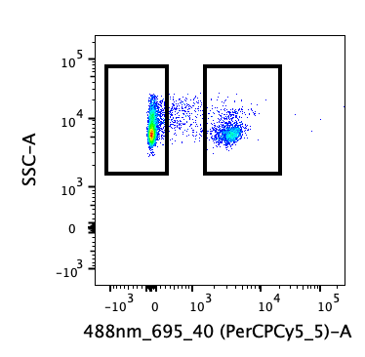
The challenge of extrinsic parameters:
Resolving signals from cell autofluorescence
Autofluorescence
(no fluorophore)
Fluorophore
(antibody or dye)
Maximizing resolution
  Marker expression
  Fluorophore brightness
  Instrument settings
Signal Specificity

Slide 5
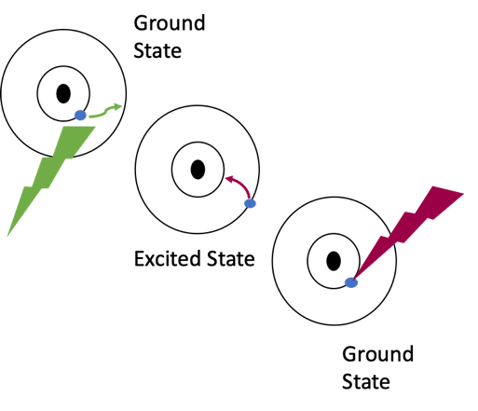
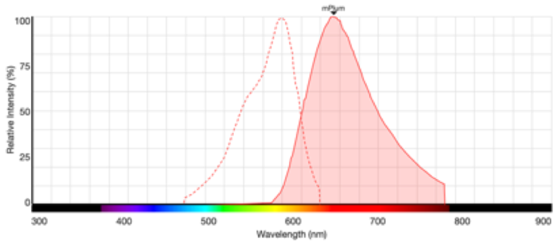
Fluorpophores and Dyes:
Excitation, Emission and Brightness
Emission
Excitation
Learn more about Fluorophores in this episode of the ChUG Podcast

Slide 6


A look inside the box
Fluidic system
Optical layout
Electronics
Detection System
Flow Cell
Sheath Tank
Laser
Analysis
Waste Tank

Slide 7

Fluidic system
Sample
Tube
Sample
Pressure
(Variable)
Sheath
Pressure
(Constant)
Waste
Tank
Sheath
Tank
Vacuum
Line Pressure

Slide 8

The Flow Cell
In order to get information about each cell individually, we need cells to pass the interrogation point one at a time
The hydrodynamic focusing within the flow cell aligns the cells

Slide 9
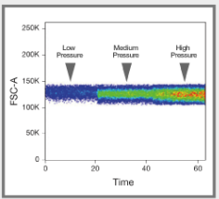
Sample Differential
Increasing the speed widens the sample core
Results in unequal illumination of cells and increase in coincidence

Slide 10
Optical bench layout
Intrinsic parameters
  Light Scatter
Lasers also excite fluorophores and dyes
  collected by a detector array

Slide 11
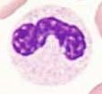

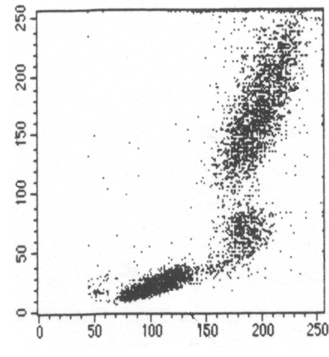

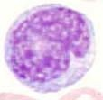

Light Scatter
Lymphocytes
Granulocytes
SSC
FSC
RBC, debris, dead cells
Monocytes

Slide 12

Traditional Flow Cytometers
FSC Detector
SSC
FITC
PerCP Cy5.5
488/10
530/30
695/40
PE
505LP
555LP
640SP
585/42

Slide 13
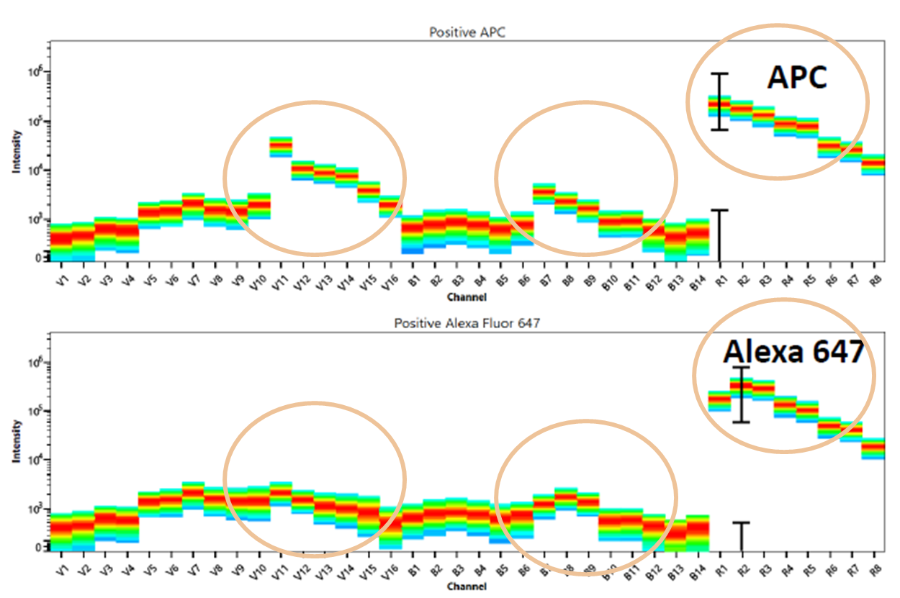
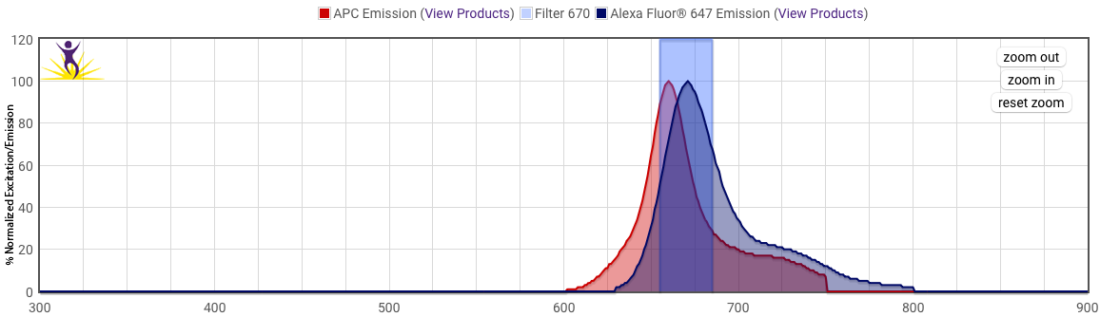
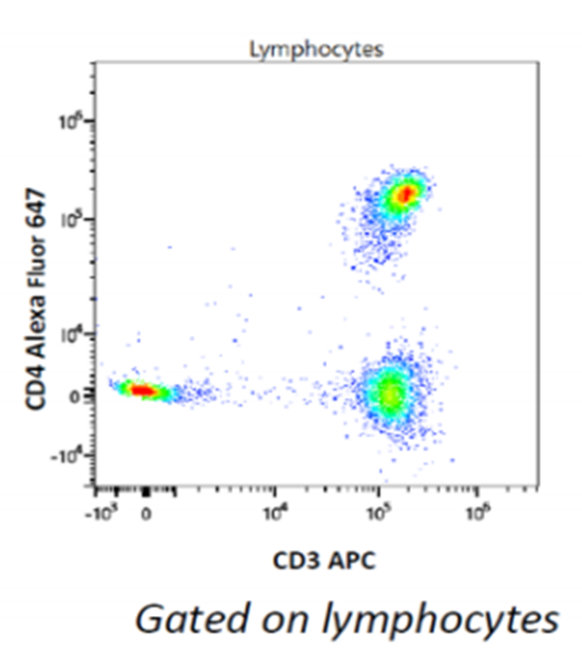
Spectral Flow Cytometry
spectral flow
Trad flow
Never have to worry about filter sets again
Separate fluorophores with similar emission
Manage larger number of markers more efficiently
Autofluorescence extraction

Slide 14


Multi-laser instruments and pinholes
Increase the number of usable markers
Reduce the amount of spillover between some combination of fluorophores
Detector Path laser 1
Detector Path laser 2

Slide 15
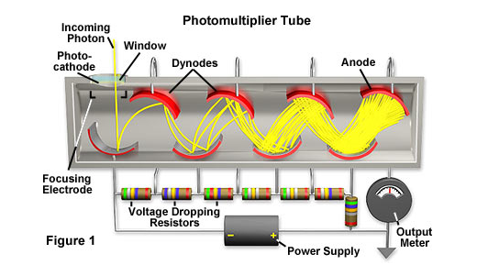
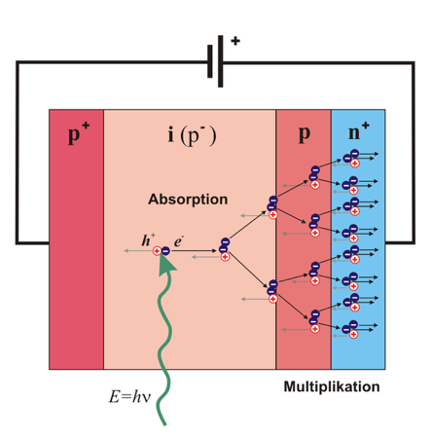
Various types of detectors used in different instruments
PMT
https://hamamatsu.magnet.fsu.edu/articles/photomultipliers.html
APD
siPM
Here is a review of the main detectors used in flow
https://commons.wikimedia.org/wiki/File:APD3_German-ru.svg

Slide 16
Threshold
Signal intensity
Time

Slide 17
The Voltage Pulse
Signal intensity
Time

Slide 18
Measurement of the pulse
Signal Intensity
Height
Area
Width
Signal Intensity
Time

Slide 19
FCS Data File
Flow Cytometry Standard (FCS)
  Accepted Standard in flow cytometry world
  Usable on third party analysis software packages
Listmode File containing
  All measurements
  Instrument settings acquisition information
  Keywords

Slide 20
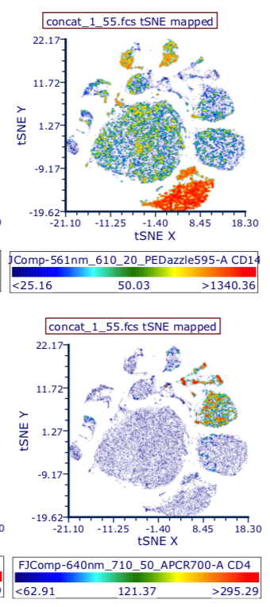
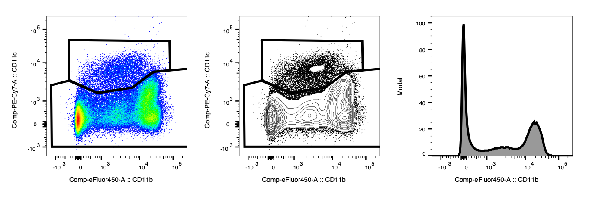
Flexibility in data presentation
Graphic analysis (typical)
Unsupervised clustering (high parameters)
Modelization

Slide 21
Panel Design
Choosing Fluorophores
Choosing Instrument

Slide 22
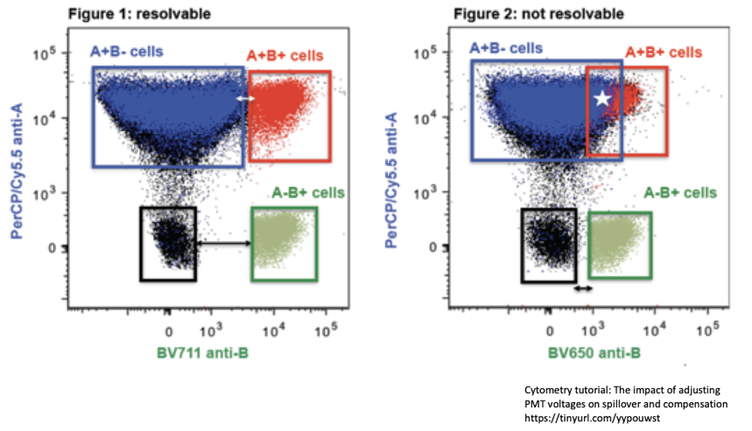
Good panel design
Great panel design aims at improving the resolution of your different markers
Variables include
  Biology of the markers
  Brightness of Fluorophore
  Spectral Overlap
Check the Sample preparation guide for more information

Slide 23
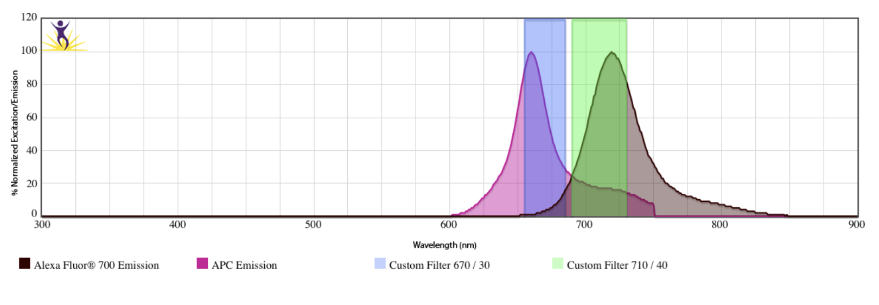
Overlapping emission generates artefact that needs to be corrected
APC stained cells
APC
AF700

Slide 24
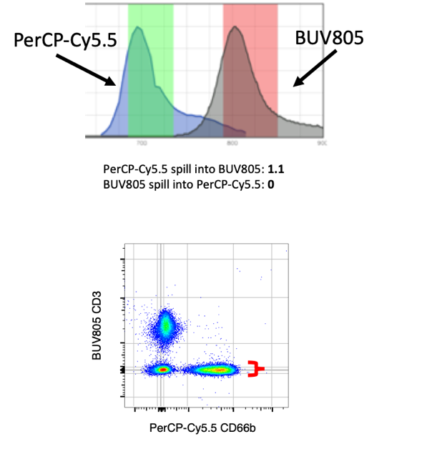
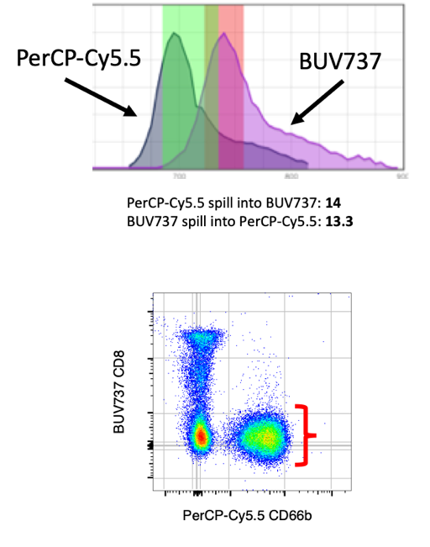
Spillover increases error spread

Slide 25
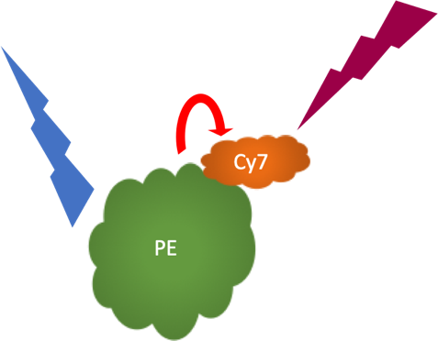
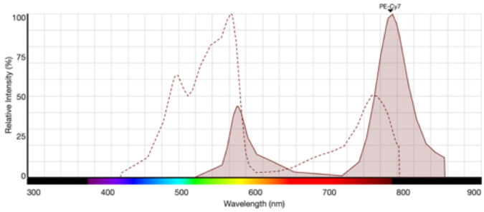
Tandem Fluorophores are great but noisy
Energy transfer by FRET but:
  Donor molecule also emits photons
  Acceptor molecule is excited by lasers as well
Tandem dyes go bad over time

Slide 26
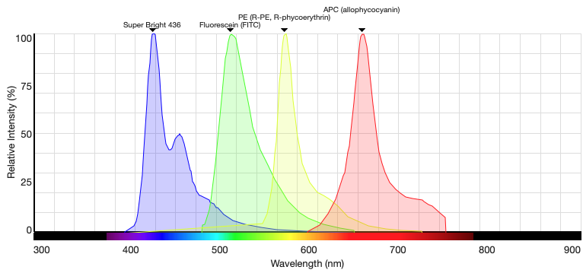
Easy start for a simple panel
Fluorophore | Laser
BV421 | 405nm
FITC | 488nm
PE | 561nm
APC | 640nm
Excited by different lasers
Non-overlapping emission
Single molecule (non-tandem)

Slide 27
Benchtop instruments variations
Usable fluorophores
  Number of lasers
  Number of measurable parameters
Features available
  Spectral unmixing
  Acoustic Focusing
  Sample Loader
  Imaging

Slide 28
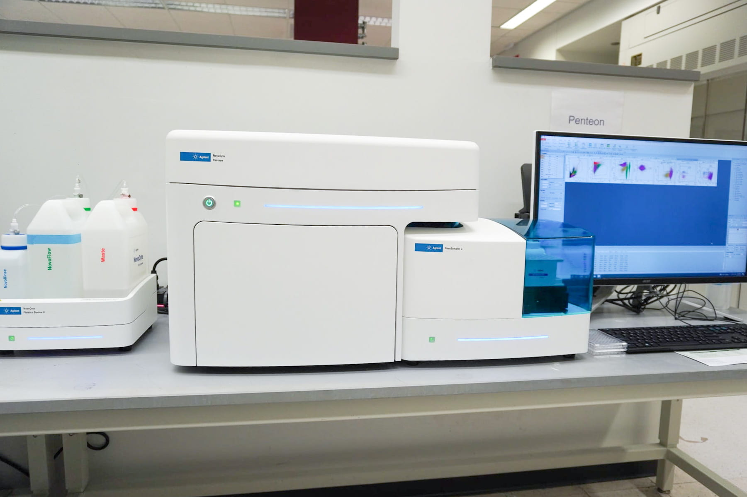
Traditional Flow Cytometers
LSRII/Fortessa
  Plate loader (1 - screening)
Attune NxT
  Acoustic Focusing
  True count
  Plate Loader
Quanteon/Penteon
  Plate Loader
  True count
  High Dynamic Range

Slide 29
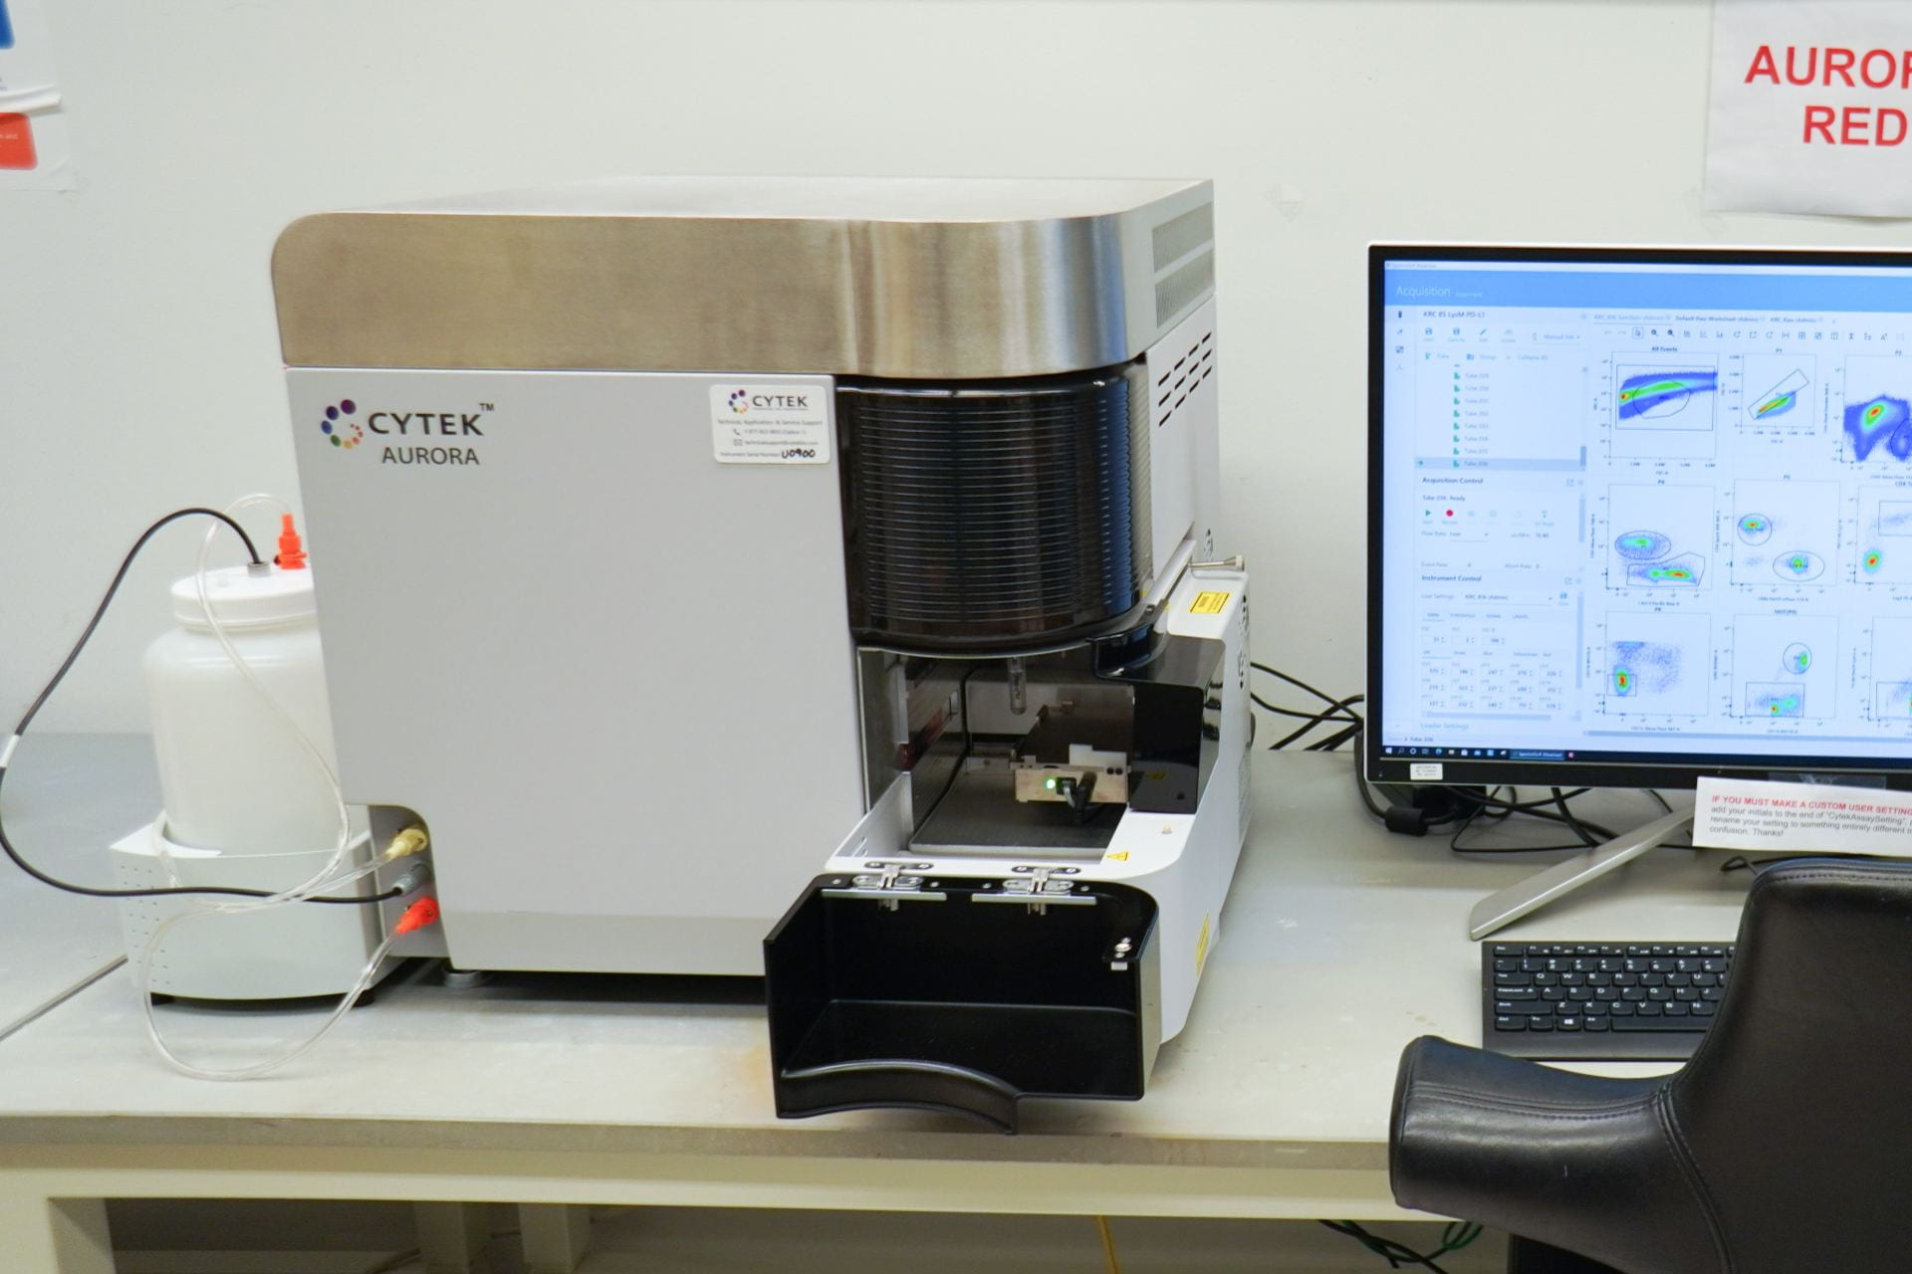
Spectral Flow Cytometers
Cytek Aurora
Measures the entire emission of each fluorophore and unmix the signal in discrete parameter measurement
Can be used as a traditional flow cytometer
Not limited by filter selection

Slide 30
Cell sorters
Flow cytometers that allows for the collection of one or multiple sub-population of cells
Droplet-based or Mechanical sorting
Staff operated in general, but training available

Slide 31
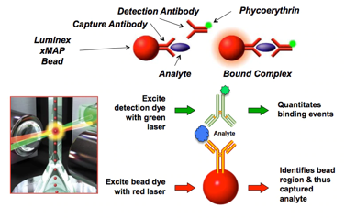
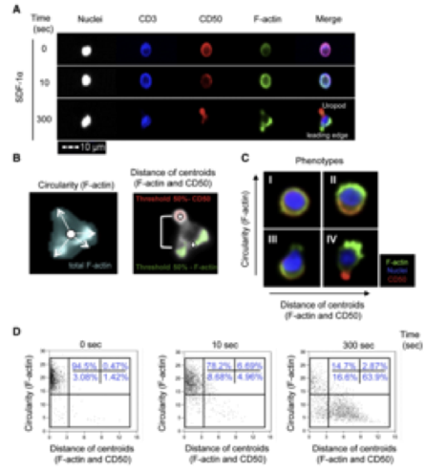
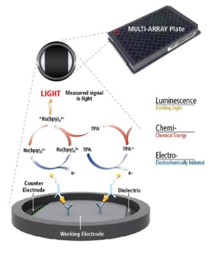
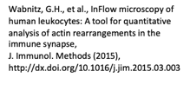
Noteworthy platforms
Image Stream MarkII
  Takes pictures of each event in up to 12 channels
Multiplexing
Luminex 200
Bead-based assay
30+ analytes
https://www.thermofisher.com/blog/behindthebench/luminex-bead-based-immunoassays-drive-immunoassays-towards-higher-content-biomarker-discovery/
MSD
ECL
Up to 10 analytes

Slide 32
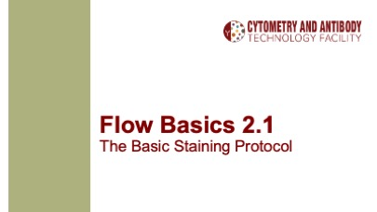
Getting data!
Single cell suspension preparation
Panel Design
  Check out Easy Panel!
Antibody validation
  Specificity
  Titration
Let’s focus on acquisition here!
Click here to access FB 2.0

Slide 33
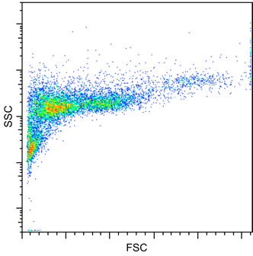
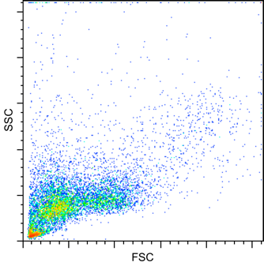
FSC x SSC
SSC on Log
 | Lin | Log
FSC | Most of the time | Small particles
SSC | SSC used to identify cluster | Complex tissue or very simple sample
SSC on Lin

Slide 34
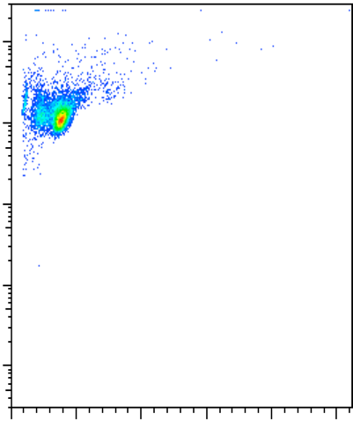
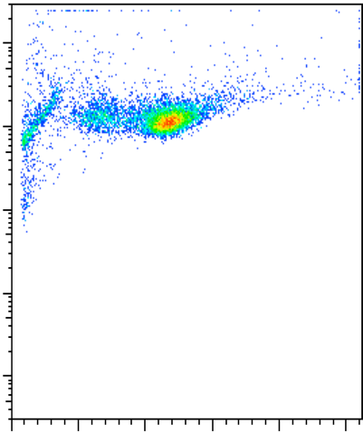
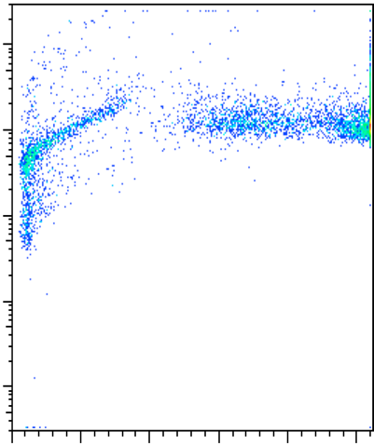
Setting up voltages on FSC vs. SSC
Bring the population of interest in the center of the graph
  Provides optimal resolution of population
  Avoid giving too much importance to debris/losing cells off-scale
SSC
FSC
Voltage

Slide 35
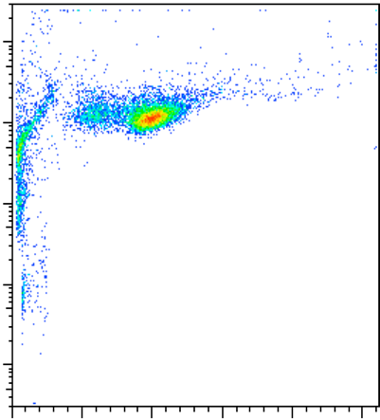

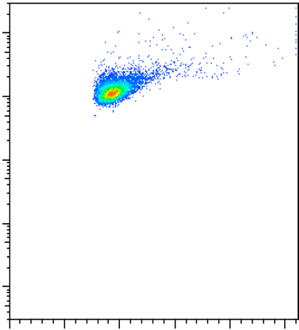
Setting up threshold
Avoid including too much debris
Make sure you are not loosing information
SSC
FSC
Threshold

Slide 36
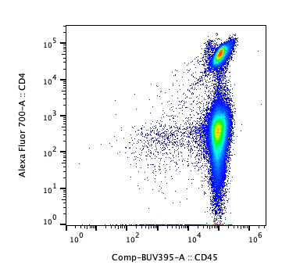
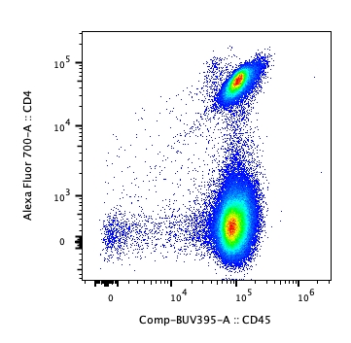
Fluorophores signal
Log scale
 | Lin | Log | BiEx (or other)
Fluorophores | Specific Applications (rare) | meh | Better!
Biexponential

Slide 37
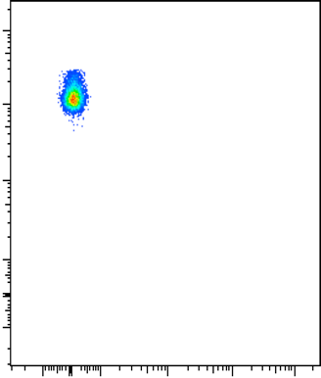
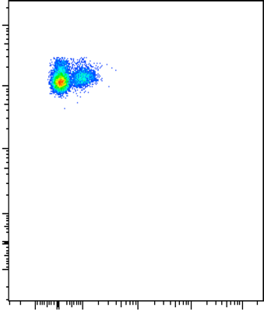
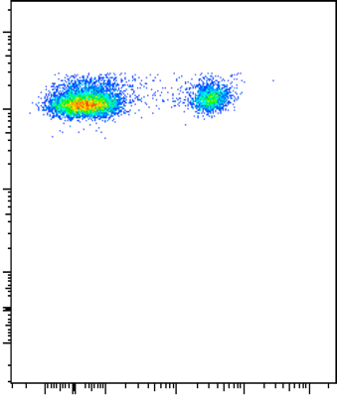
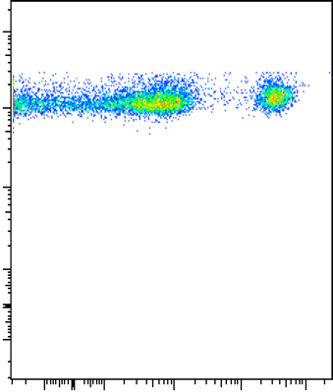
Fluorophore detectors voltage
Voltage needs to be high enough to allow for resolution of the positive and negative fractions
Voltage set too high does not provide better resolution but increase noise in negative fraction
SSC
PE
Voltage

Slide 38
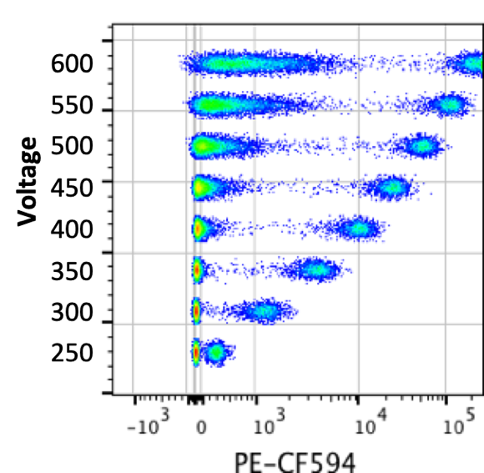
Default instrument values are optimized
The instruments have been characterized and the optimal voltage/gain values are set in the default experiment settings
You may need to lower voltage / gain to avoid strutting the detector
You don’t win anything by increasing the values

Slide 39
Exercise: How do these fluorophore voltages look?
1A
2A
3A
4A
1B
2B
3B
4B

Slide 40
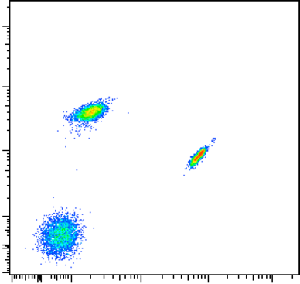
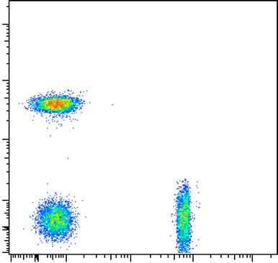
Dealing with spillover
Uncorrected
Signal correction in multi-parameter experiment made necessary by fluorophore spectral overlap
Compensation
  Substraction of a percentage of the signal of a fluorophore (that happens to be bleeding in another detector) from the measured light in that detector
Unmixing
  Calculate the contribution of each known fluorophore’s spectra to the total collected emission signal
Corrected
PE
Alexa 488

Slide 41
Do you need compensation controls?
What strategy did you use?
Avoidance
Overlapping fluorophores
Pick fluorophores which will not overlap with one another
No need for controls
If spillover can’t be avoided, correction is needed
Prepare single-stained controls
Notes:
Something about how the data should look like in the end

Slide 42
Spillover controls
Compensation controlrules
  Must have a positive / negative fraction
  The positive and negative fraction must have the same baseline autofluorescence
  Positive fraction’s brightness similar or higher than sample
  Use the same fluorophores / dyes for sample and controls
  Save a good number of events for both positive and negative fraction
Use of software recommended (necessary in the case of unmixing)
You will need to run your set of controls and compensate on each new experiment
More information on compensation on our website

Slide 43
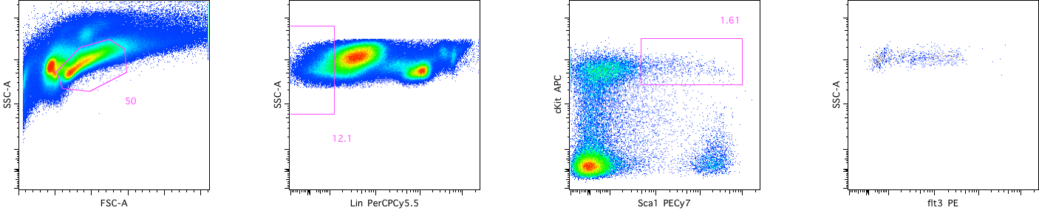
Data Analysis
Cleaning Data
Gates justification

Slide 44
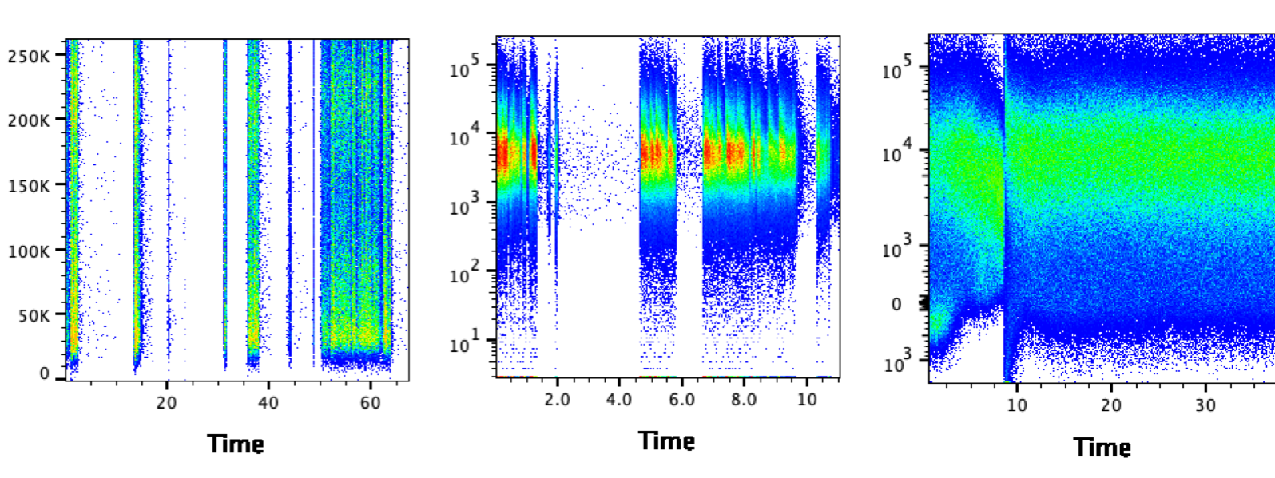
Cleaning Up Data I
Removing Doublets
Removing Acquisition Mishap

Slide 45
Cleaning Up Data II
Removing Dead Cells

Slide 46
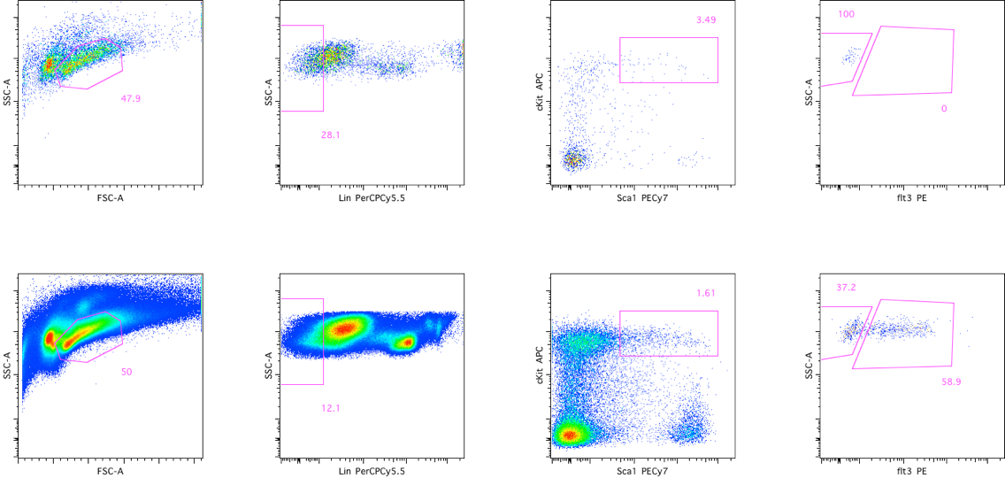
Deciding on gates:
FMO Controls
FMO PE
Sample

Slide 47
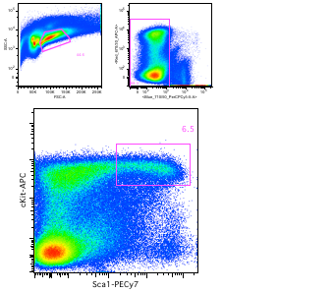
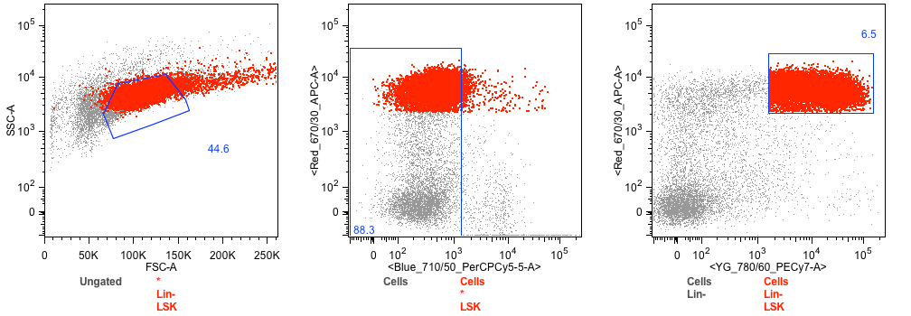
Deciding on gates:
Backgating

Slide 48
Resources
CAT Facility website
ChUG Website

Slide 49
Acknowledgment
Purdue University Cytometry Laboratories website: http://www.cyto.purdue.edu/
  Dr. Robert Murphy, Carnegie Mellon University- Basic Theory 1 and 2 powerpoint slides
Sydney Cytometry Facility tutorial: The impact of adjusting PMT voltages on spillover and compensation
BioLegend spectraviewer
ThermoFisher spectraviewer
ThermoFisher website training material

